Slide 1
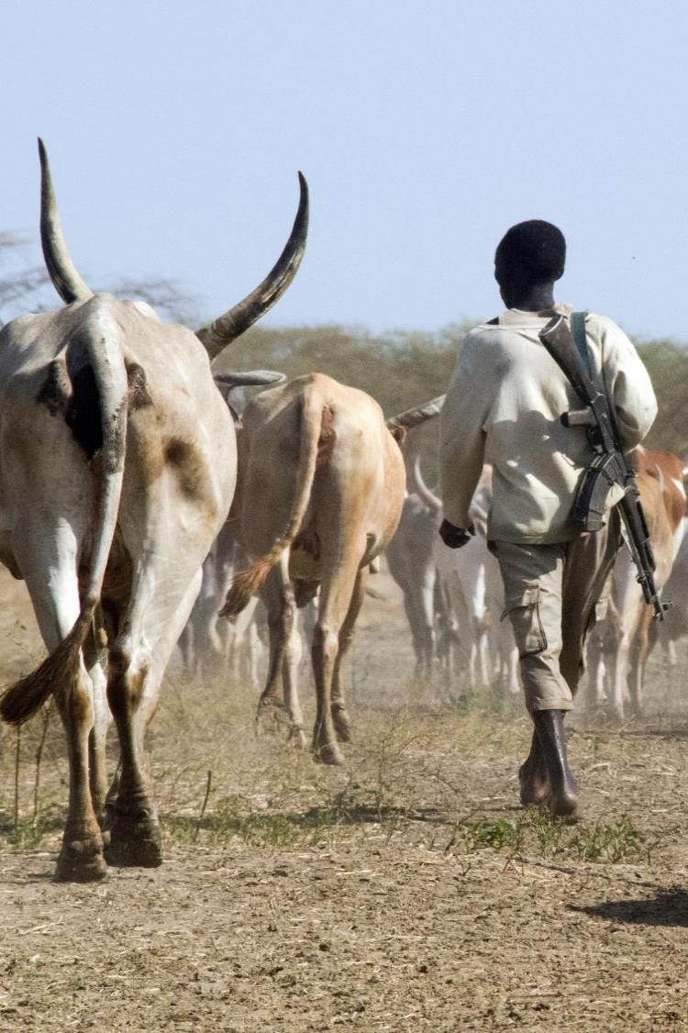
Food Security and Famine: Numbers, evidence and driving factors
Luca Russo,
Senior Food Crises Analyst
Food and Agriculture Organization of the United Nations (FAO)

Slide 2
What do we mean when we talk of food insecurity and why numbers are different?
Notes:
Both reports represent multi-partnership efforts aiming to complement each other in providing a comprehensive picture of food security/insecurity around the world. Yet, they have well distinguished objectives and rely on different data and methodologies.
What does the SOFI aim at?
Assessing the achievement of SDGs by monitoring long term trends in chronic food insecurity and malnutrition regardless of the driving causes;
What data does it present?
Official statistics from member countries are used to assess the achievements of SDG indicators endorsed by the UN statistical commission, and more particularly, to monitor Targets 2.1 and 2.2 of the Agenda 2030 for Sustainable Development;
What audience does it target?
Governments, international agencies, academia, media and anyone interested in the long-term evolution of food security and nutrition.

Slide 3
State of Food Insecurity in the World (SOFI)
What purpose?
  Assessing the achievement of SDGs by monitoring long term trends in chronic food insecurity and malnutrition regardless of the driving causes;
What data?
  National official statistics to monitor the achievement of Targets 2.1 and 2.2 of the Agenda 2030 for Sustainable Development;
What audience?
  Governments, international agencies, academia, media and anyone interested in the long-term evolution of food security and nutrition.
Notes:
Both reports represent multi-partnership efforts aiming to complement each other in providing a comprehensive picture of food security/insecurity around the world. Yet, they have well distinguished objectives and rely on different data and methodologies.
What does the SOFI aim at?
Assessing the achievement of SDGs by monitoring long term trends in chronic food insecurity and malnutrition regardless of the driving causes;
What data does it present?
Official statistics from member countries are used to assess the achievements of SDG indicators endorsed by the UN statistical commission, and more particularly, to monitor Targets 2.1 and 2.2 of the Agenda 2030 for Sustainable Development;
What audience does it target?
Governments, international agencies, academia, media and anyone interested in the long-term evolution of food security and nutrition.

Slide 4
Global Report on Food Crises
What purpose?
  Assessing acute food insecurity stemming from major crises at the national and sub-national level; famine prevention;
What data?
  Short-term estimates of ‘peak’ food insecurity mainly based on available IPC and Cadre Harmonisé reports;
What audience?
  Donors and policy makers that operate in humanitarian and resilience contexts.
Notes:
What does the Global Report aim at?
Providing a national and sub-national focus on the food insecurity causes in hotspots and assessing acute food insecurity stemming from major crises;
What data does it present?
Secondary information mainly based on available Integrated Food Security Phase Classification (IPC) and Cadre Harmonisé reports that provide short-term estimates of ‘peak’ food insecurity;
What audience does it target?
The Report provides the most recent and up-to-date information to donors and policy makers that operate in humanitarian and resilience contexts.

Slide 5
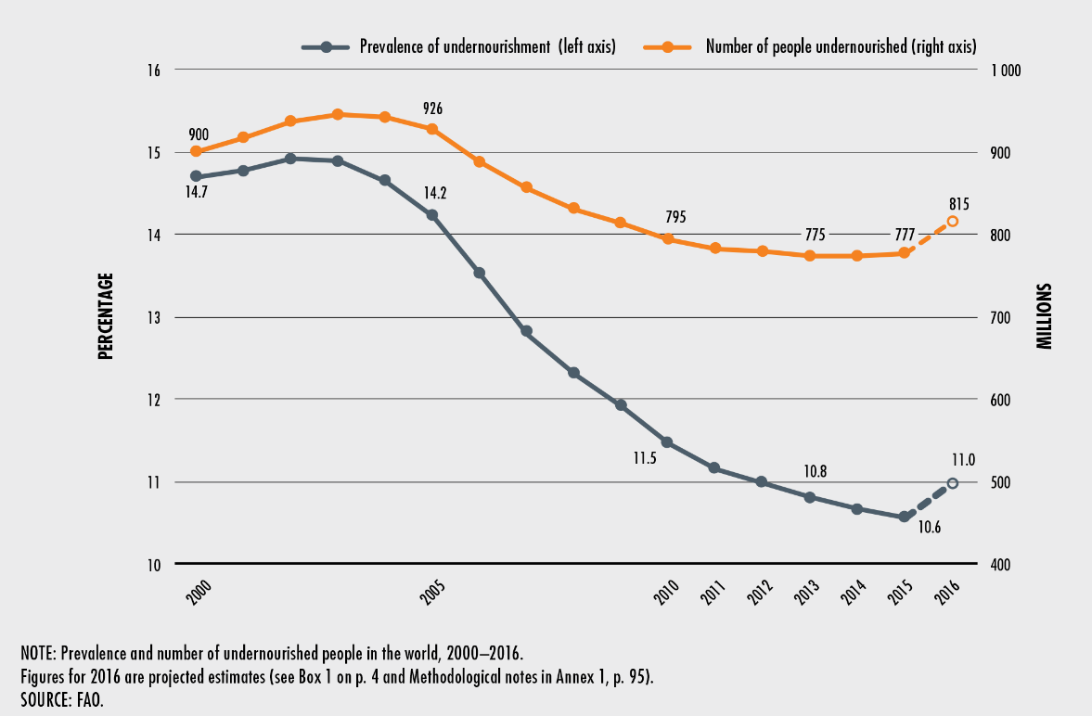
The State of Food Security and Nutrition in the World 2017 (SOFI)
The number of undernourished has been on the rise since 2014,
reaching
815 million people
in 2016
Notes:
The most recent PoU estimates** show that, despite significant population growth, the share of undernourished people in the world decreased from 14.7 percent in 2000 to 10.8 percent in 2013.
**the prevalence of undernourishment (PoU), is an estimate of the proportion of the population that has been in a condition of undernourishment over the reference period (usually one year). Undernourishment is defined as the condition in which an individual’s habitual food consumption is insufficient to provide the amount of dietary energy required to maintain a normal, active, healthy life
However, this rate of reduction has slowed significantly recently, coming to a virtual halt between 2013 and 2015.
Most worryingly, estimates for 2016 indicate that the global prevalence of undernourishment in 2016 may have actually risen to 11 percent, implying a return to the level reached in 2012 and suggesting a possible reversal of the downward trend sustained over recent decades.
The absolute number of people in the world affected by chronic food deprivation began to rise in 2014 and is now estimated to have increased further, to 815 million in 2016.
The deterioration was most severe in Sub-Saharan Africa and South East Asia.
Sub-Saharan Africa remains the region with the highest PoU , affecting an alarming 22.7 % of the population in 2016. The situation is urgent in Eastern Africa , where 1/3 of the population is estimated to be undernourished – the sub-region’s PoU increased from 31 in 2015 to almost 34 % in 2016.
The recent increase in the prevalence of undernourishment can be attributed to a variety of factors. New information from food commodity balances for many countries points to recent reductions in food availability and increases in food prices in regions affected by El Niño / La Niña-related phenomena – most notably in Eastern and Southern Africa and in South-Eastern Asia.
In addition, the number of conflicts has increased in the past decade, in particular in countries already facing high food insecurity and with much of the related violence affecting rural areas and having a negative impact on food production and availability. This surge in conflicts has affected African and Near East nations the most and led to food-crisis situations, especially where compounded by droughts or other weather-related events and fragile response capacities.
Worsening food security conditions have also been observed in more peaceful settings, particularly where economic slowdowns have drained foreign exchange and fiscal revenues. This has affected both food availability by reducing import capacity, and food access owing to more limited fiscal space to protect poor households against rising domestic food prices, as seen for example in parts of Latin America and Western Asia.
The Caribbean (17.7 percent) and Asia (11.7 percent overall, with peaks of 14.4 percent in Southern Asia) also continue to show a high PoU. In contrast, levels remain low in Latin America, although there are signs that the situation may be deteriorating, especially in South America, where the PoU climbed from 5 percent in 2015 to 5.6 percent in 2016.

Slide 6
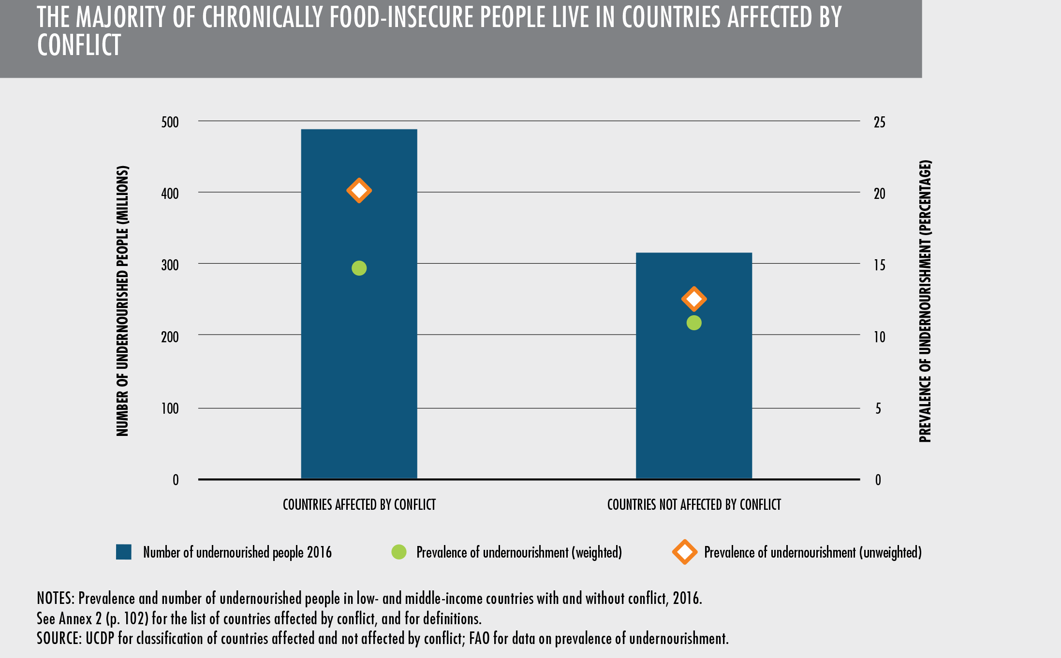
SOFI 2017
The majority of chronically
food-insecure people live in countries affected by conflict
Notes:
Conflict is a key factor explaining the apparent reversal in the long-term declining trend in global hunger, thereby posing a major challenge to ending hunger and malnutrition.
Simple correlations show higher levels of chronic food insecurity in countries affected by conflict. In 2016, the unweighted average of the prevalence of undernourishment in countries affected by conflict was almost eight percentage points higher than countries not affected by conflict. (The difference is four percentage points when weighting for population size.)
As such, the majority of hungry people live in countries affected by conflict: 489 million out of a total of 815 million chronically undernourished in 2016.

Slide 7
SOFI 2017
Comparing conflict and non conflict countries in both prevalence and absolute numbers show higher values for conflict affected countries
Notes:
Comparing conflict and non conflict countries in both prevalence and absolute numbers show higher values for conflict affected countries:
See CAR, Uganda Vs Kenya, (for prevalence)
See Nigeria Vs Senegal (for absolute numbers)
People living in countries affected by conflict, such as CAR, Uganda (conflict in the last 20 years) or Nigeria, are more likely to be food insecure and undernourished. More strikingly, while most countries have achieved significant 25-year gains in reducing hunger and undernutrition, such progress has stagnated or deteriorated in most countries experiencing conflict.
The Central African Republic is an example of the complexity and intractability of so-called conflict and violence traps and the impact these have on food security and nutrition: half of the population currently faces hunger (almost 60% of people undernourished), which poses a threat not only to those suffering but also to the stabilization process in the entire country.

Slide 8
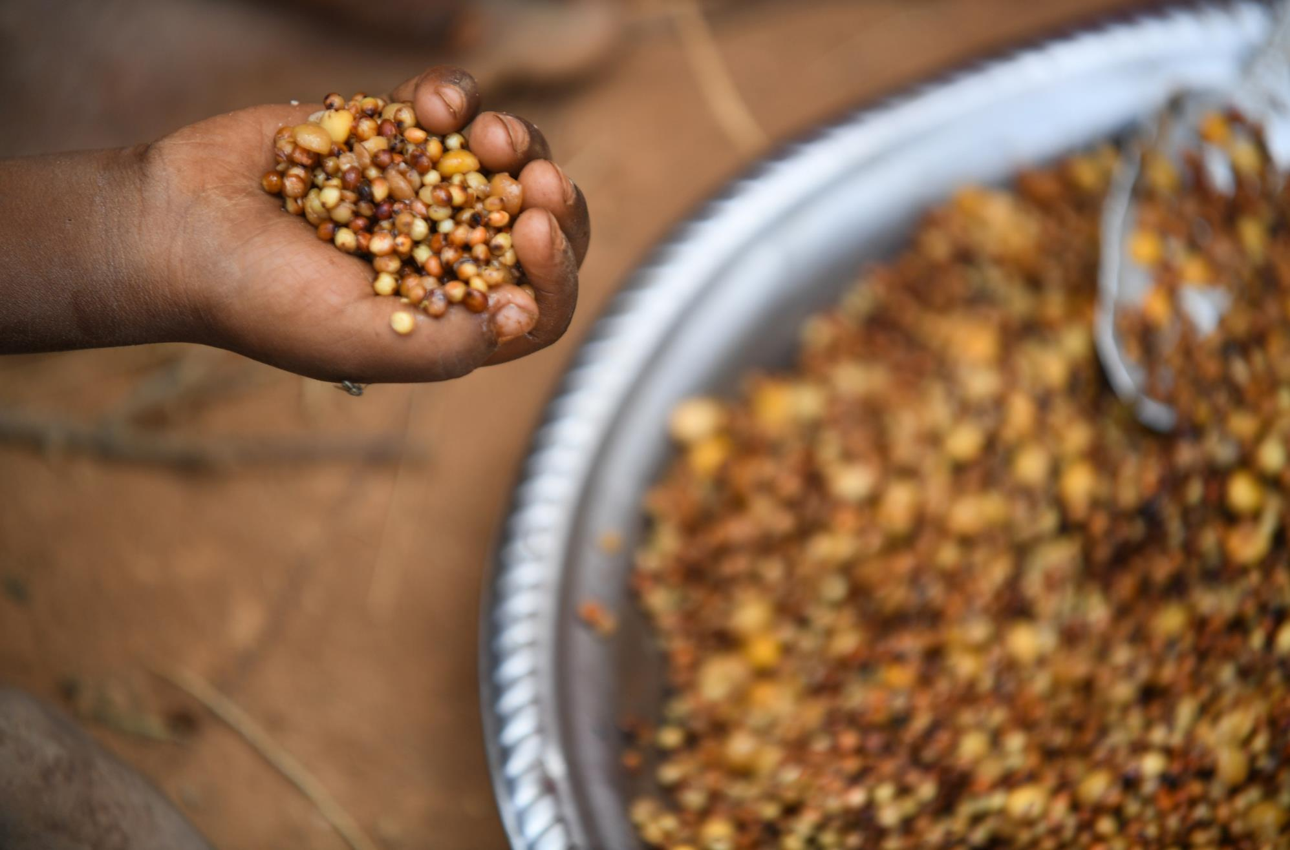
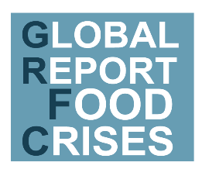




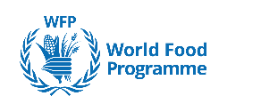




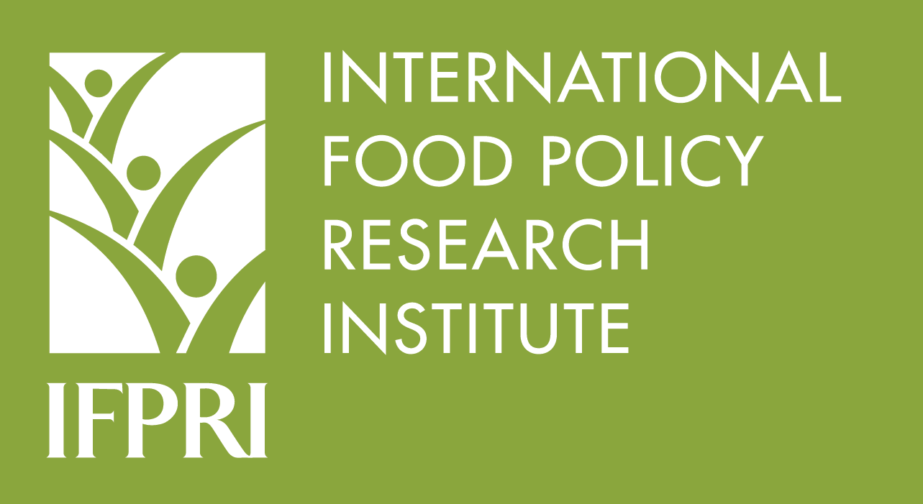


GLOBAL REPORT ON FOOD CRISES
What? A global public good ensuring that humanitarian and development partners work from the same page
Why? A credible evidence-based analysis for response towards the Humanitarian-Development-Peace nexus
Who? 12 global and regional partners providing joint food security and nutrition analysis under the umbrella of the Food Security Information Network
When? 2017 data and projection for 2018
O
N

Slide 9
Integrated Food Security Phase Classification (IPC) & Cadre Harmonisé (CH)
Phase 1:
Minimal
Phase 2:
Stressed
Phase 3:
Crisis
Phase 4:
Emergency
Phase 5:
Famine
Usually adequate and stable food access
Borderline adequate food access
Highly stressed and critical lack of food access with high and above usual malnutrition and accelerated depletion of livelihood assets
Severe lack of food access with excess mortality, very high and increasing malnutrition, and irreversible livelihood asset stripping
Extreme social upheaval with complete lack of food access and/or other basic needs where mass starvation, death, and displacement are evident
Notes:
The report uses the IPC / CH classification of food insecurity. It focuses on countries where large sections of population are faced with acute severity of food insecurity meaning facing IPC / CH phases 3 and above (Crisis, Emergency and Catastrophe conditions).
Famine is declared when there is evidence of the following three conditions in a single location
Food Shortages : At least 20% of the population faces extreme food shortages
Acute Malnutrition: At least 30% of children suffer from acute malnutrition
Increased Mortality: Daily deaths occur at double the normal rate

Slide 10
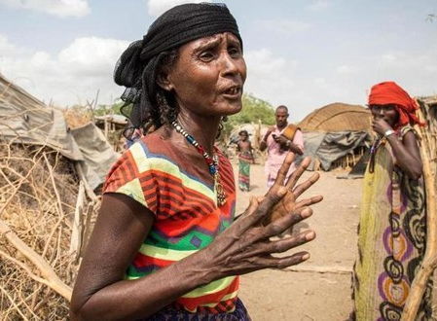
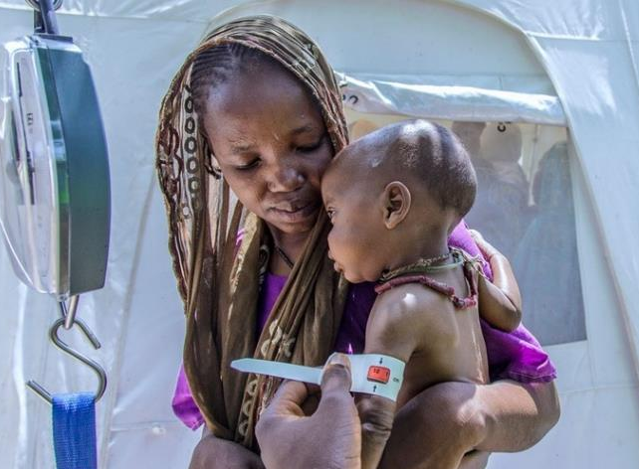
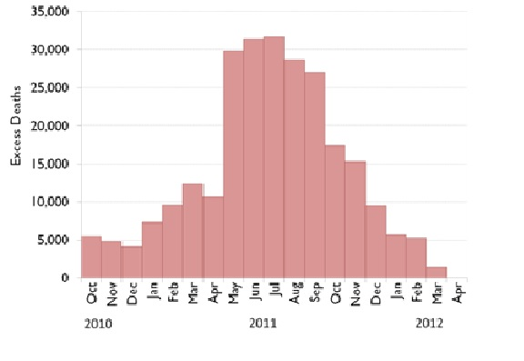
Famine is an acknowledgment of collective failure
Mortality
Famine is declared when there is evidence of the following three conditions in a single location
Food Shortages
At least 20% of the population
faces extreme food shortages
Acute Malnutrition
At least 30% of children suffer
from acute malnutrition
Increased Mortality
Daily deaths occur at double
the normal rate
Notes:
Famine is declared when there is evidence of the following three conditions in a single location
Food Shortages : At least 20% of the population faces extreme food shortages
Acute Malnutrition: At least 30% of children suffer from acute malnutrition
Increased Mortality: Daily deaths occur at double the normal rate

Slide 11

KEY FIGURES
MAIN CAUSES OF THE INCREASE
124 million people across 51 countries facing Crisis (IPC/CH Phase 3) food insecurity or worse
Overall an increase of 16 million or 15% more people compared with previous year report
An increase of 11 million or 11% more people in the 45 countries analyzed in both 2017 and 2018 report
52 million children under-5 acutely malnourished
17 million children under-5 severely malnourished
  New outbreaks and intensified conflict & insecurity e.g. Yemen, Northern Nigeria, Democratic Republic of Congo, South Sudan and Myanmar
  Consecutive climate shocks affecting livestock and agricultural production e.g. eastern and southern Africa
O
N
Notes:
Countries which are not covered because of lack of data while data were available last year are:
Dem Pop. Rep. of Korea;
Côte d’Ivoire
Countries/territories added this year (were not included last year but for which data became available this year):
El Salvador;
Pakistan;
Occupied Palestinian Territory;
Sri Lanka;
Ukraine

Slide 12
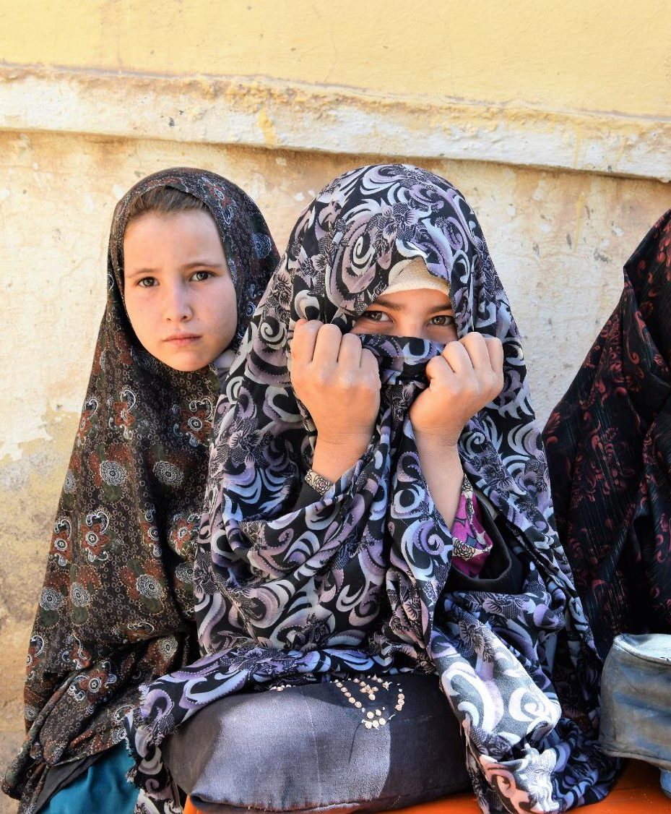
CONFLICT AND INSECURITY
18 countries or territories with almost 74 million food-insecure people in need of urgent assistance
  11 countries in Africa - about 37 million food- insecure people
  4 countries in the Middle-East – about 27 million food-insecure people
  2 countries in Asia – over 8 million food-insecure people
  1 country in Europe - over 1 million food-insecure people
Very high rates of acute child malnutrition are found in areas affected by conflict
  North Darfur in Sudan; South Sudan; Lac region of Chad; northern Nigeria
155 million children under-5 are stunted of whom 122 million (80 percent) live in fragile and conflict affected states
O
N
Notes:
List of countries to be inserted in the notes:
11 countries in Africa: Burundi, CAR, Chad, DRC, Libya, Mali, Niger, north Nigeria, Somalia, South Sudan and Sudan;
4 countries in Middle-East: Iraq, Palestine, Syria, Yemen;
2 countries in Asia: Afghanistan, Myanmar
1 country in Europe: eastern Ukraine
Many of the countries profiled in the report experienced SEVERE OUTBREAKS OF CHOLERA in 2017. These include particularly conflict affected countries where access to health and sanitation services is particularly curbed. In these countries is also difficult to contain the and treat diseases which also increases the levels of malnutrition
Countries are: Yemen – almost 1 million cases, DRC, South Sudan , Borno state in Nigeria, Somalia etc…

Slide 13
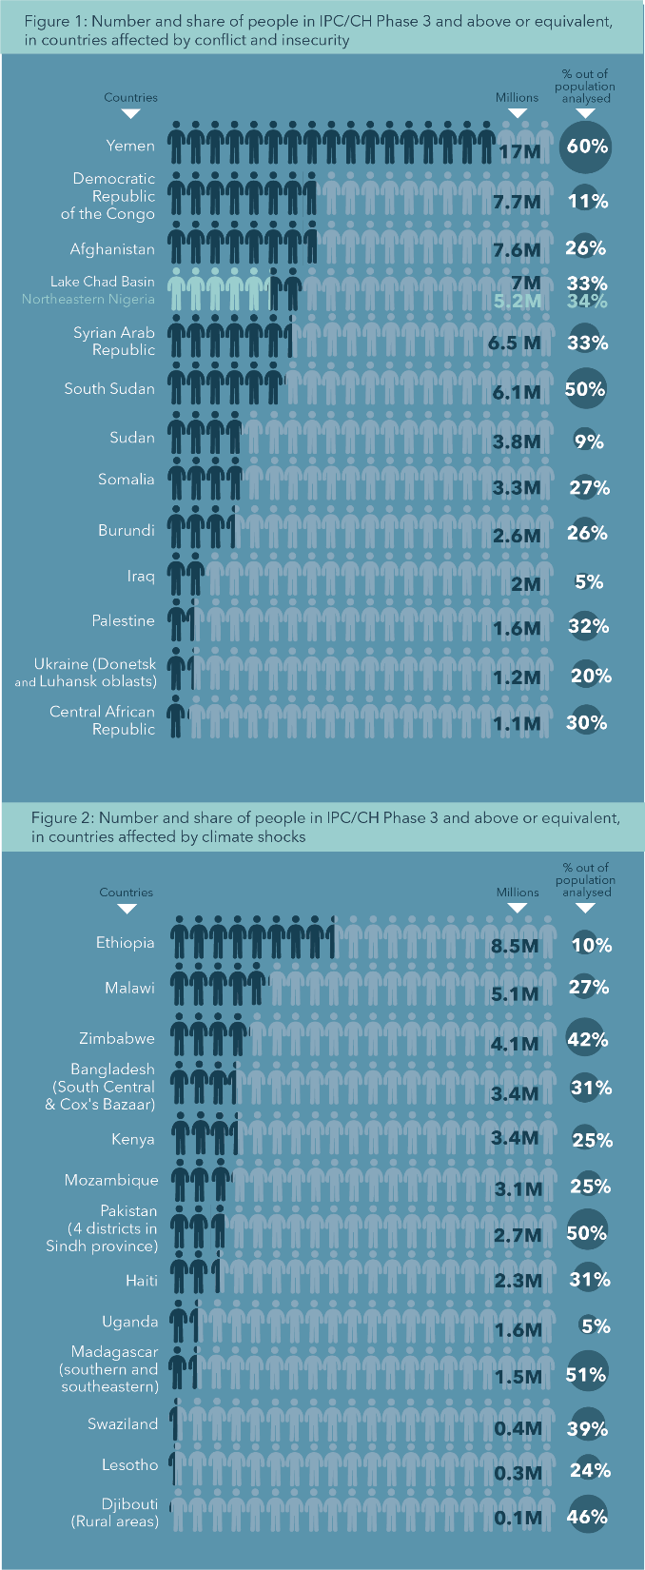
Number of people in hunger Crisis or worse in countries affected by conflict

Slide 14

CLIMATE SHOCKS
23 countries with over 39 million food-insecure people in need of urgent assistance
  15 countries in Africa – almost 32 million people food- insecure
  3 countries in South Asia - over 4 million people food- insecure
  5 countries in Latin America & the Caribbean – over 3 million people-food insecure
High acute malnutrition rates persist particularly in areas with climate shocks
  Northern Kenya, Sindh province in Pakistan, Ethiopia and Madagascar
O
N
Notes:
List of countries to be inserted in the notes:
15 countries in Africa: Angola, Djibouti, Ethiopia, Kenya, Lesotho, Madagascar, Malawi, Mozambique, Namibia, Sierra Leone, South Africa, Swaziland, Tanzania, Zambia and Zimbabwe;
3 countries in South Asia: Nepal, Pakistan, Sri Lanka;
5 countries in Latin America and the Caribbean: El Salvador, Guatemala, Haiti, Honduras, Nicaragua.

Slide 15
Number of people in hunger Crisis or worse in countries affected by climate shocks

Slide 16
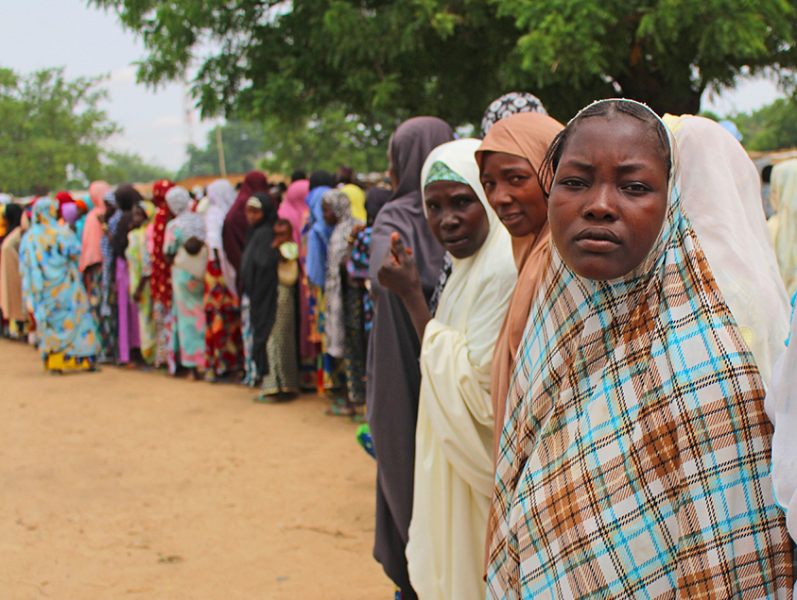
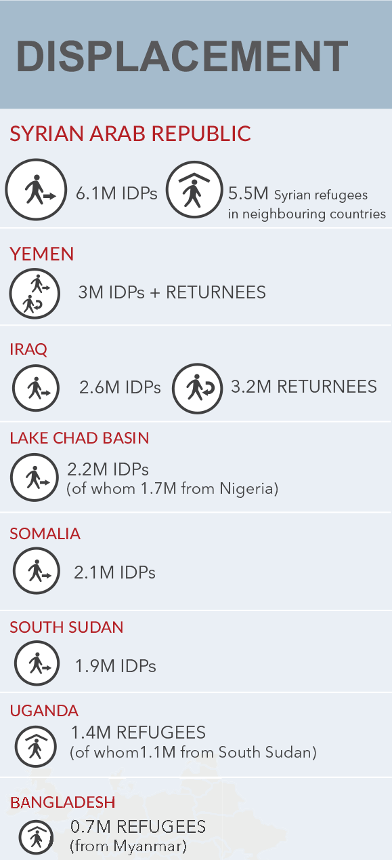
Combination of conflict and climatic events has fostered large-scale displacement
(internal & external)
Notes:
Conflict and climatic events have fostered large displacement (internal & ext.);
Conflict and natural disasters have often occurred simultaneously which led to significant displacement associated with both – e.g. Ethiopia, Nigeria, Somalia, and Sudan.
High staple food prices have curtailed food access and reinforced food insecurity.
Weather-induced crop production shortfalls triggered sharp cereal price increases – e.g. Kenya, Ethiopia, Somalia, Sudan and Uganda.
Floods in Bangladesh and drought conditions in Sri Lanka reduced rice production, pushing prices to record levels.
Conflict and insecurity, which disrupts market functionality, also induced price spikes in Nigeria, South Sudan, Yemen and Burundi.

Slide 17
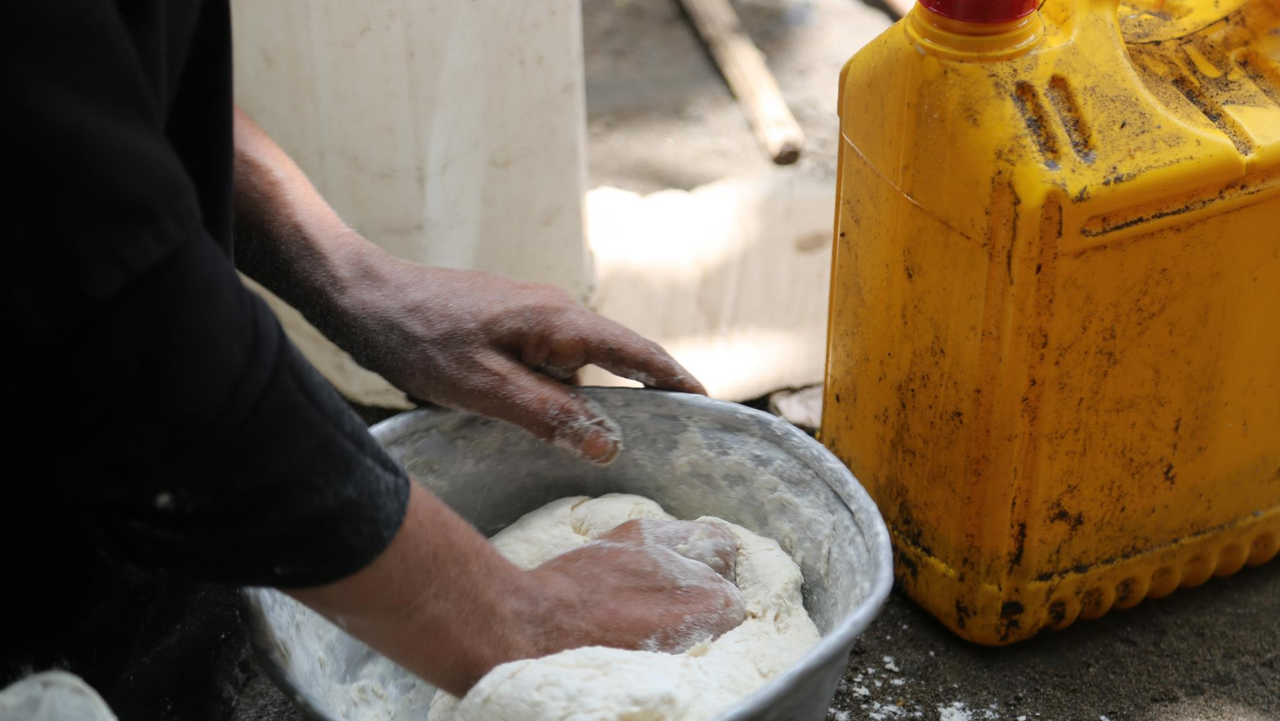
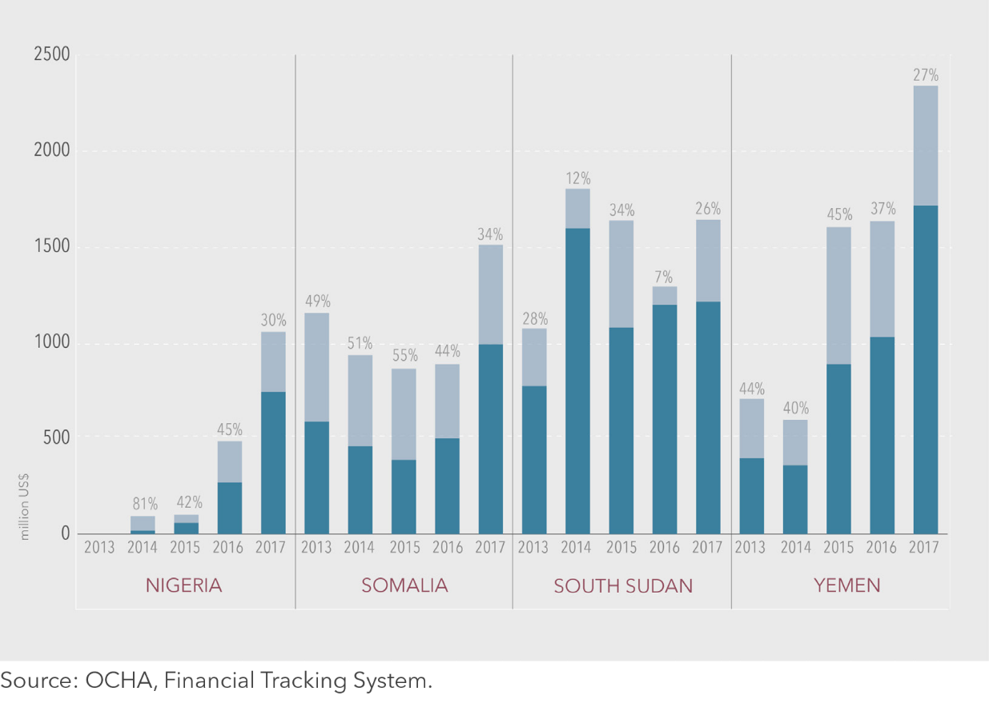
THE FOUR MOST SEVERE FOOD CRISES OF 2017
Peak of food insecurity in 2017
Yemen – 17 million (60%)
South Sudan – 6.1 million (50%)
Somalia – 3.3 million (27%)
Northeast Nigeria – 5.2 million (34%)
  Almost 32 million people in Crisis food insecurity and above
  18 % increase from 2016
  – almost 5 million people
  Greatest increases in South Sudan & Yemen – 23% & 20% respectively
  Humanitarian funding requirement has more than doubled – from
  some 2.9 billion USD in 2013 to
  more than 6.5 billion USD in 2017
  Funding gap: around 29% in all countries
Unmet requirements (in million USD and in percentage)
Response plan/appeal funding (in million USD)
Notes:
In these four countries, a total of 31.6 million people were classified in IPC/CH Phase 3 (Crisis) and above in 2017 – an increase of 18 percent compared to 2016 (almost five million people);
South Sudan and Yemen have registered the greatest increases in magnitude of food insecurity – at 23 percent and 20 percent, respectively;
In these 4 countries, over 10 million people are currently displaced from their homes with an overall increase of vulnerability to food insecurity.
The requirement of humanitarian funding in these four countries has more than doubled, from approximately 2.9 billion USD in 2013 to more than 6.5 billion USD in 2017

Slide 18
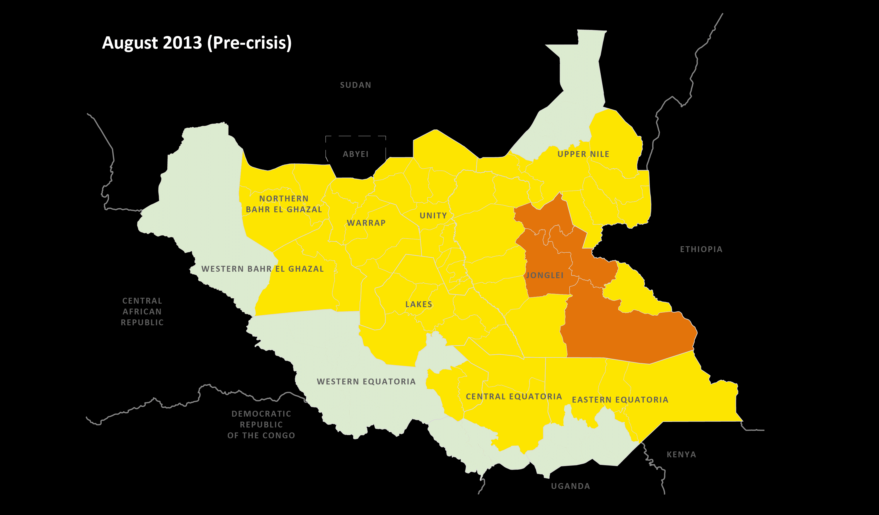
SOUTH SUDAN
SOUTH SUDAN
Notes:
Declaration of famine: February 2017 in Mayendit in February 2017.
2017 – peak in hunger – 6.1 million people in Crisis food security (IPC Phase 3) and worse (June/July)
2018 – 7.1 million people will likely be in Crisis food security and worse (May/July)
2017 – people in Catastrophe (IPC Phase 5) declined from 100 000 (Feb.) to 40 000 (Sep.)
2018 – people in Catastrophe likely to rise (155 000 people) – but NO area classified as Famine
The nutrition situation is not always impacted by the food security alone, the presence of disease outbreaks, access to health services, the feeding and care practices, access to clean safe water, sanitation facilities all have an impact on the nutrition situation. When the analysis is done together it is easier to pull out the underlying factors affecting food security and nutrition in an area for more targeted and appropriate response.

Slide 19
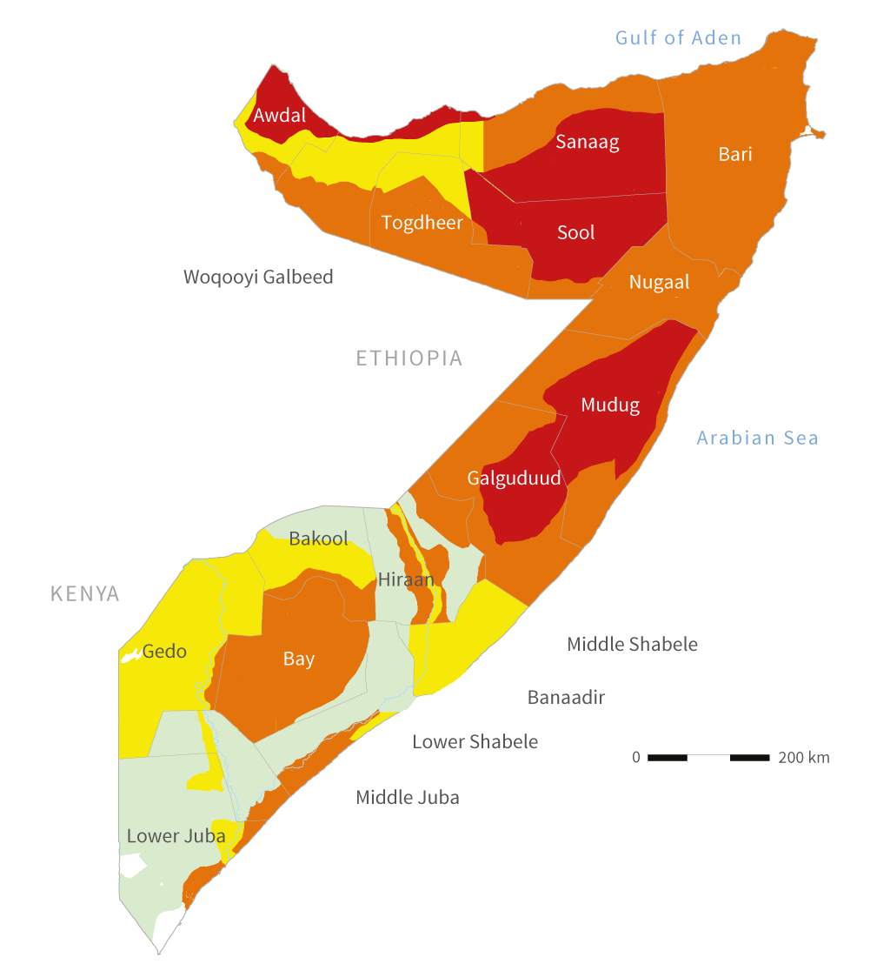
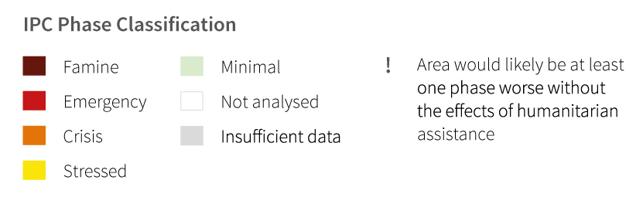
SOMALIA
ACUTE FOOD INSECURITY SITUATION (February – June 2018)
Drought conditions continued until late 2017 and are expected to affect 2018 production – 4th consecutive season
2017 – peak in hunger – 3.3 million people in Crisis (IPC Phase 3) and Emergency (IPC Phase 4) – (Aug.)
The number of people tripled between July 2016 and 2017
– from 1 million to 3 million people
2018 – 2.7 million people through
June are expected to be in Crisis and Emergency food insecurity levels
Sustained humanitarian assistance
still needed
Notes:
Drought conditions continued until late 2017 and the number of people requiring urgent humanitarian assistance remained extremely high throughout the year.
The number of people estimated to be in Crisis (IPC Phase 3) and Emergency (IPC Phase 4) between July 2016 and 2017 increased threefold, accounting for one in four Somalis.
Figure: 3.3 million people in IPC Phase 3 (Crisis) and Phase 4 (Emergency) in July 2017
Some 1.2 million children were projected to be acutely malnourished from September 2017 to September 2018, including 87,250 severely malnourished

Slide 20
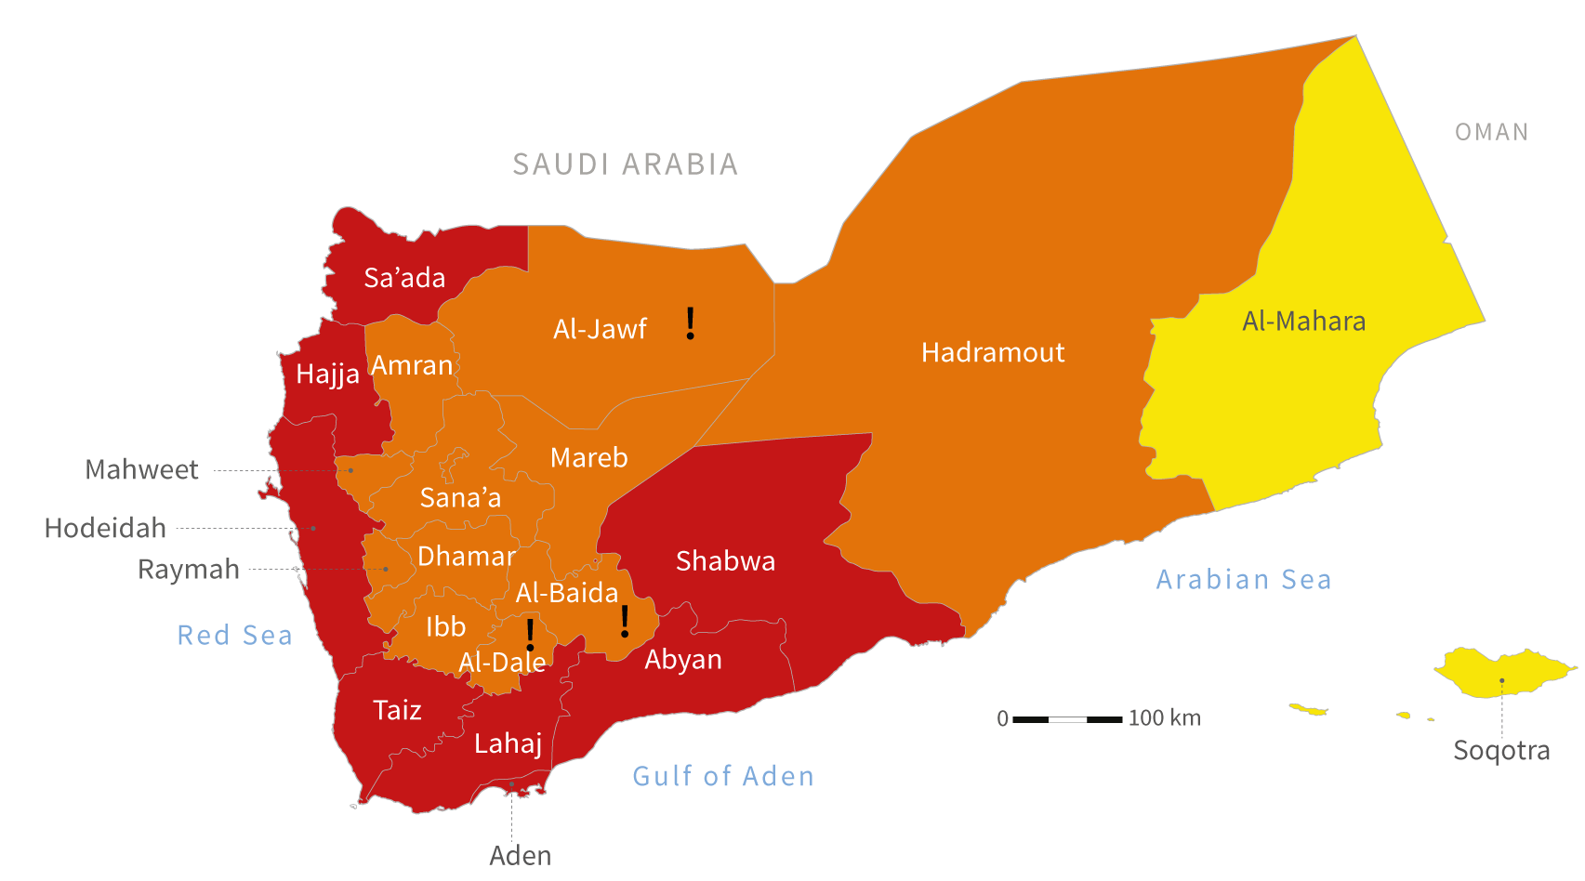
YEMEN
ACUTE FOOD INSECURITY SITUATION (March – July 2017)
Access issues due to conflict dynamics
Persisting conflict and livelihood disruptions eroding households’ purchasing power to access food
2017 – 17 million people in Crisis
(IPC Phase 3) levels of food security or worse
2018 – humanitarian situation expected to deteriorate particularly in the southern, western and northern governorates
Notes:
Access issues due to conflict dynamics are at the heart of the problem including the poor frequency and coverage of data collection that is vital for targeting humanitarian assistance.
Persisting conflict and livelihood disruptions are continuing to erode households’ purchasing power to access food.
Only 61 percent of humanitarian requirements for 2017 were met.
As of March 2017, an estimated 17 million people were facing Crisis (IPC Phase 3) levels of food security or worse, including 7 million people in Emergency (IPC Phase 4).
The closure of critical seaports and airports enforced throughout most of November 2017 by the Saudi-led coalition disrupted the humanitarian and commercial supply pipelines and prevented critical supplies, including medicines, from reaching the country.
To-date, Yemeni major ports (Al Hudaydah, Salif, Aden) remain officially open and imports continue to flow in – though at lower levels compared to the situation prior to the blockade. Clearly, after the imports are received by the country, it is still a challenge to deliver to those in need as the infrastructure is crumbling.
As Yemen is heavily reliant (i.e. at 90%) on imported staple food commodities, the depreciation of Yemeni Rial (across the 13-targeted governorates, the average rate recorded in February 2018 was 478 YR/USD which represents an increase of 122% compared to the pre-crises period (February 2015) of the Yemeni Rial value against the U.S dollar) has significant impact on the escalation of the prices in the local markets. As a result, some basic food and essential commodities are too expensive for many Yemenis who are struggling with depleted purchasing power due to loss of income and employment opportunities.
The combination of decreased commercial imports below requirement levels, and lack of access to trade and humanitarian assistance could likely lead to Famine (IPC Phase 5) food security outcomes. extracted from FEWSNET (update – March 2018).

Slide 21
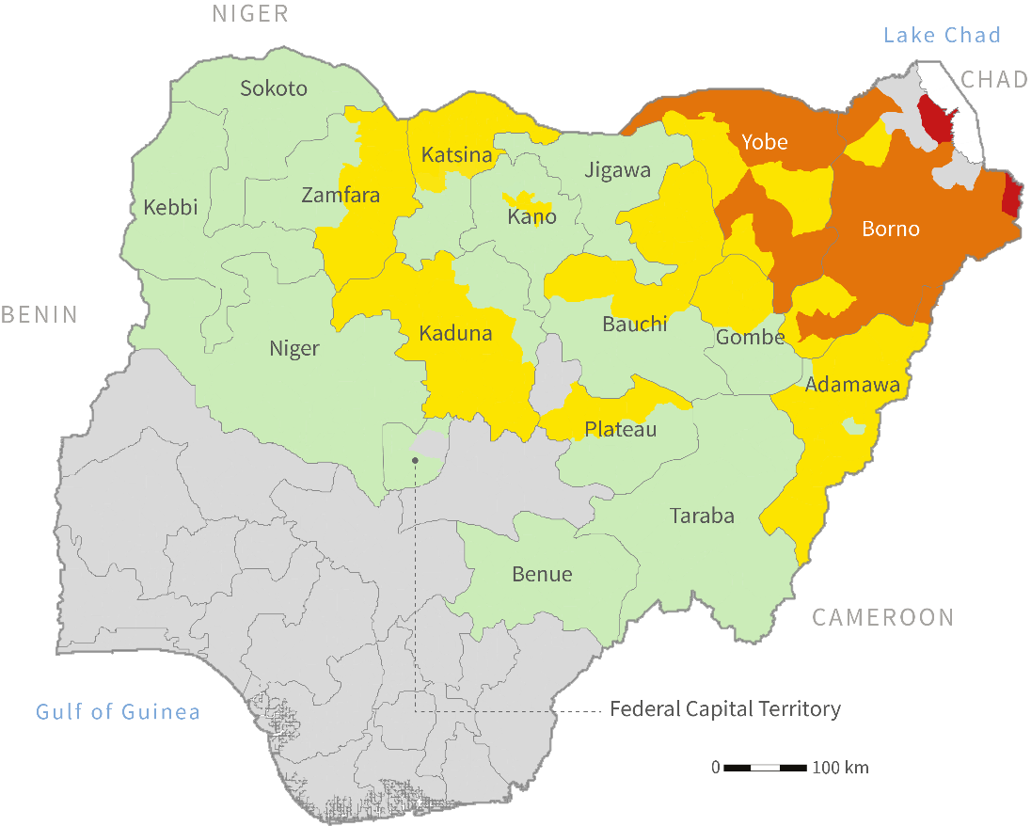
NORTHEAST NIGERIA
ACUTE FOOD INSECURITY SITUATION (June – August 2018)
Lack of access due to conflict
and insecurity
2017 – 5.2 million people in Crisis (CH Phase 3),
Emergency (CH Phase 4)
and Famine (CH Phase 5) –(June/August)
2018 – 3 million people expected to face Crisis and Emergency food insecurity
No one is expected to face Famine (CH Phase 5)
Notes:
Although progress has been made to improve accessibility, several areas in the northeast still remain unreachable as a result of conflict and insecurity.
Over the last year, humanitarian organizations and the Government have massively scaled up assistance to prevent Famine (CH Phase 5) outcomes.
There is a continued need for longer-term approaches to support recovery opportunities, including livelihoods assistance.
June-August 2017: 5.2 million people in Crisis (CH Phase 3) and worse, including 50,000 people in Famine (CH Phase 5).
The situation is expected to improve by June-August 2018 with 3.7 million people in Crisis (CH Phase 3) and worse, including 13,000 people in Famine (CH Phase 5)

Slide 22
LAKE CHAD BASIN
ACUTE FOOD INSECURITY SITUATION (June – August 2018)
Continuous restrictions to the circulation of people and goods hinder transhumance;
2017 – 7.0 million in need of urgent food assistance across affected areas of the 4 countries;
2018 – 4.7 million likely to require urgent assistance in food by June-August;
Around 250,000 people are expected to remain in Emergency (CH Phase 4) across affected areas of Chad, Niger and Nigeria during the pre-harvest season.
Notes:
Despite security improvements in the Lake Chad Basin, restrictions to the circulation of people and goods between states hinders transhumance across pastoralist areas;
2017 – 5.5 million people in Crisis (CH Phase 3) across affected areas of Niger, Nigeria and Chad – 7.0 million in need of urgent food assistance if including affected areas in Cameroon;
2018 – 3.2 million people in Crisis (CH Phase 3) across affected areas of Niger, Nigeria and Chad – 4.7 million in need of urgent food assistance if including affected areas in Cameroon;
Although significant improvements have been made in terms of responding to famine (CH Phase 5) in the region – no one is concerned as of 2018 - around 250,000 people are still expected to face Emergency (CH Phase 4) across affected areas of Chad, Niger and Nigeria during the pre-harvest season.

Slide 23
SAHEL – Burkina Faso, Chad, Mali, Mauritania, Niger, Senegal
ACUTE FOOD INSECURITY SITUATION (June – August 2018)
2017 – some 4.2 million people were food insecure and required urgent food assistance during the lean season;
civil insecurity, decreased agricultural production and poor pastoral conditions likely to impact the food security in pastoralist areas in 2018;
2018 – around 5.0 million people are likely to face Crisis (CH Phase 3) food security outcomes between June-August
Notes:
The Global Report on Food Crises indicates that between June and August 2017, some 4.2 million people were food insecure and required urgent food assistance across Burkina Faso, Chad, Mali, Mauritania, Niger and Senegal. Between June and August 2017:
around 257,000 people in Burkina Faso,
897,000 people in Chad,
600,000 people in Mali,
281,000 people in Mauritania,
1.3 million in Niger
and 829,000 people in Senegal were in Crisis (CH Phase 3) food security conditions or worse.
In 2018, civil insecurity continues to disrupt transhumance, markets and agro-pastoral productive capacities as well as to cause further displacements
Most affected areas: the Lake Chad Basin, northern and central Mali and the Liptako-Gourma region (Burkina Faso, Mali, and Niger).
In addition, important decrease of agricultural production and poor pastoral conditions due to poor rainfalls in 2017 have limited the constitution of food stocks and assets , which is likely to impact the food security of pastoral populations, in particular, and trigger an early lean season.
Most affected areas: certain parts of Mali, Senegal, Chad, and Burkina Faso as well as almost all regions of Mauritania
As such, the situation is expected to significantly deteriorate in the pre-harvest period (June-August) as 5.0 million people are likely to face Crisis (CH Phase 3) food security outcomes across the six countries , according to the latest Cadre Harmonisé analysis released in March:
around 954,000 people in Burkina Faso,
991,000 people in Chad,
933,000 people in Mali,
538,000 people in Mauritania,
803,000 in Niger
and 735,000 people in Senegal are expected to face Crisis (CH Phase 3) food security conditions or worse between June and August 2018

Slide 24
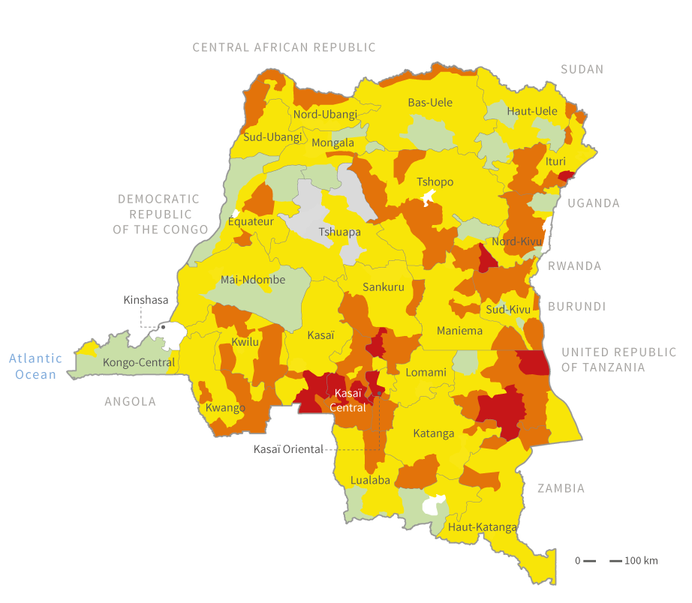
DEMOCRATIC REPUBLIC
OF THE CONGO
ACUTE FOOD INSECURITY SITUATION (June – December 2017)
Between June and December 2017,
7.7 million people
– 11% of the population – were facing Crisis or worse food security
1.5 million people
in Emergency
(IPC Phase 4)
food security
86% of people in
IPC Phase 4 were in
the provinces of
Kasai and Tanganyika
Notes:
Between June and December 2017, some 7.7 million people -11 percent of the population – were facing Crisis (CH Phase 3) or worse food security outcomes.
Around 86 percent of the 1.5 million people facing Emergency (IPC Phase 4) conditions were in the provinces of Kasai and Tanganyika, which are both classified in IPC Phase 4 – though neither of them was a year earlier.
Confidential information still to be added.

Slide 25
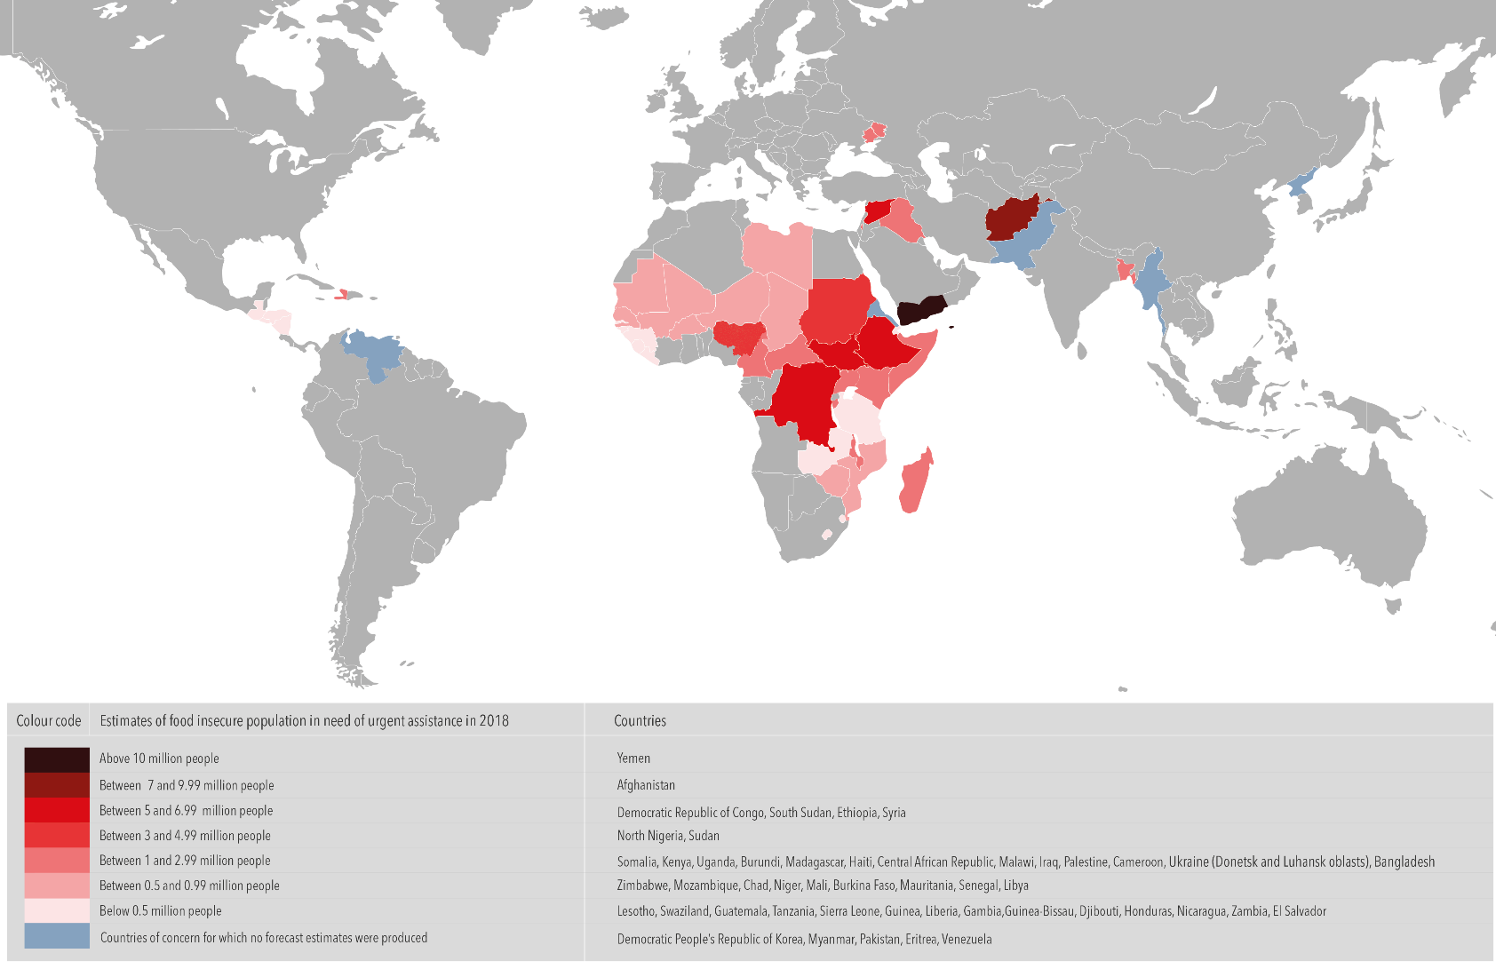
FOOD INSECURITY SHORT TERM OUTLOOK FOR 2018
Notes:
Protracted conflict in the Middle-East (Yemen, Syria, Iraq, Palestine);
Displacement and insecurity in southern and central Asia (Afghanistan, Myanmar, Bangladesh);
Unresolved conflict and insecurity in central and eastern Africa (South Sudan, DRC, CAR, Burundi, Sudan);
Conflict, insecurity and drought in West Africa and Sahel (north-eastern Nigeria, Chad, Niger, Senegal, Mali, Mauritania, Burkina Faso);
Erratic weather in southern Africa (Zimbabwe, Mozambique, Madagascar);
Drought in East Africa (Somalia, Ethiopia, Kenya, Uganda);
Hurricanes and abnormal dryness in Latin America and the Caribbean (Guatemala, Haiti);
Additional countries to be monitored: DPRK, Congo, Cameroon, Libya and Venezuela.

Slide 26
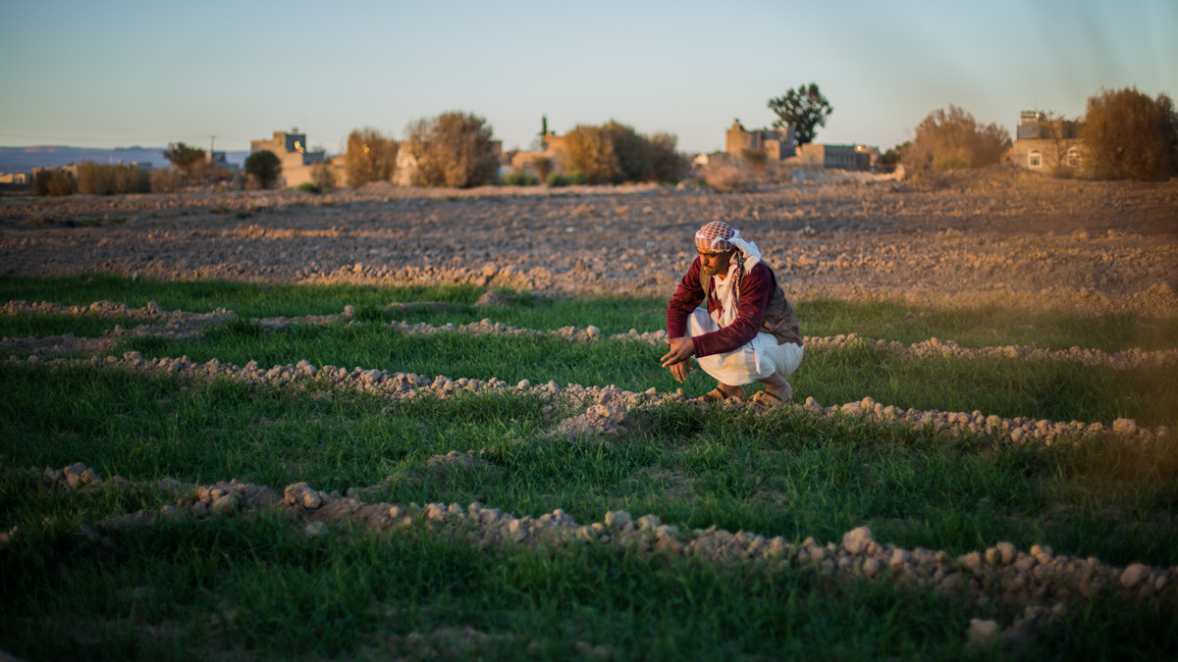

From analysis to consensus building and coordination

Slide 27
Global Network Against Food Crises
WHS - May 2016: launched by EU Commissioners, FAO DG and WFP ED to enhance the impact of prevention and response action to food crises.
Long term vision: promote synergies and coordination to address food crises along the Humanitarian-Development-Peace nexus.
1st achievement: Global Report on Food Crises to provide evidence for decision making and resource allocations.
Notes:
the idea of a Network against food crises was first launched at the initiative of the European Union Commissioner for Development, the Director-General of FAO and the Executive Director of WFP on the occasion of the World Humanitarian Summit in May 2016.

Slide 28
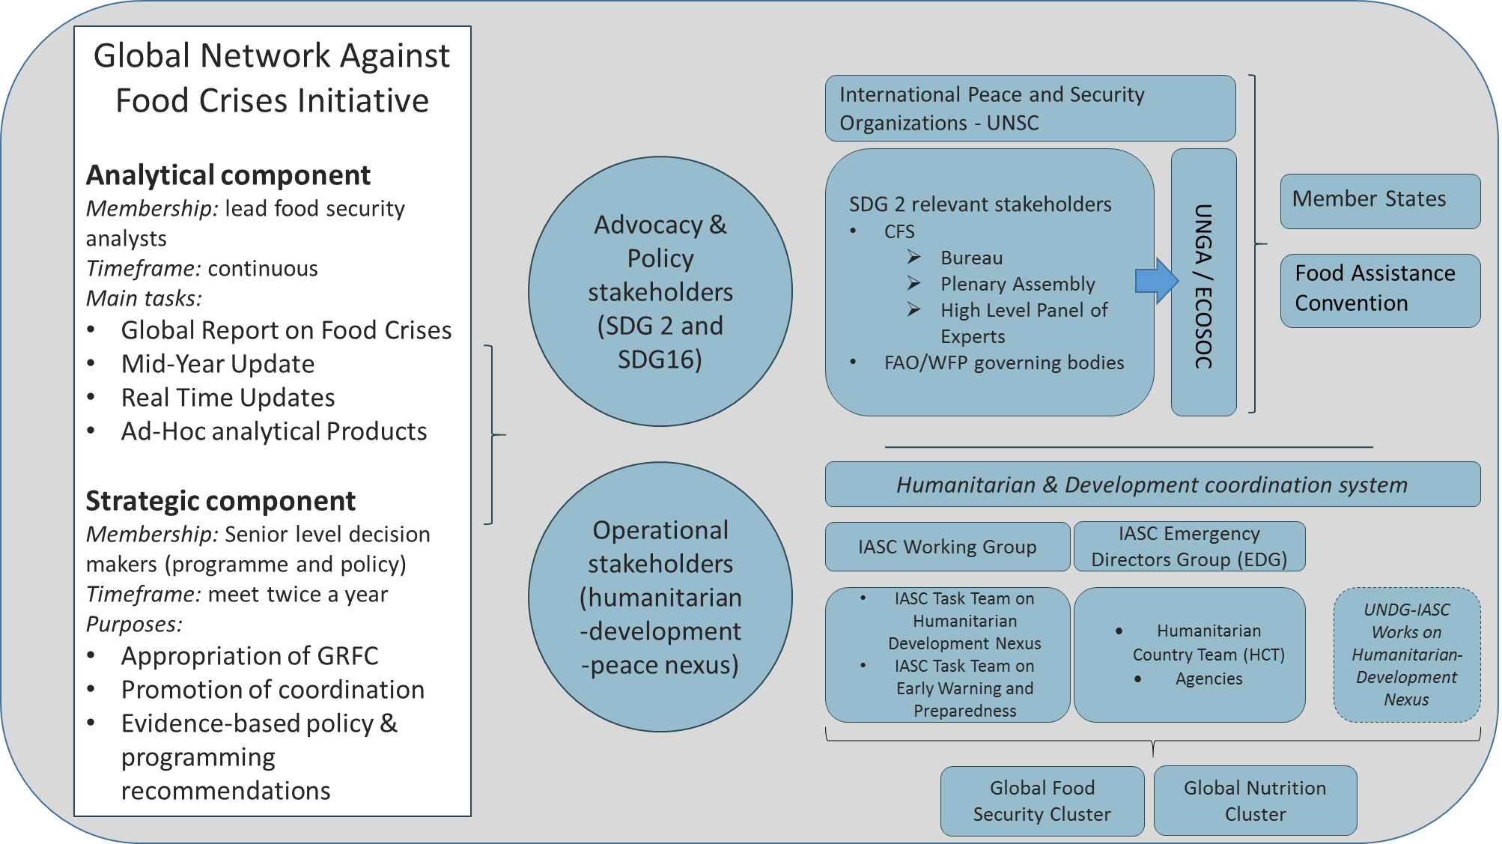
/ UNGA
Notes:
the idea of a Network against food crises was first launched at the initiative of the European Union Commissioner for Development, the Director-General of FAO and the Executive Director of WFP on the occasion of the World Humanitarian Summit in May 2016.
Examples of some institutions and organs which could take part to the Global Network Against Food Crises in accordance with their functions/objectives:
The UN Security Council is the one of the main UN organs and has the primary responsibility of maintaining international peace and security;
The Committee on World Food Security is the most inclusive international and intergovernmental platform for all stakeholders working in a coordinated manner to ensure food security and nutrition for all. Using a multi-stakeholder, inclusive approach, CFS develops and endorses policy recommendations and guidance on a wide range of food security and nutrition topics.
Among its main bodies:
The Bureau is the executive arm of the CFS. It is made of a Chairperson and twelve member countries;
The Plenary session is held annually and is the central body for decision-taking, debate, coordination, lesson-learning and convergence by all stakeholders at a global level on food security issues;
The High Level Panel of Experts on Food Security and Nutrition (HLPE) was established as the science-policy interface of the CFS: it aims to improve the robustness of policy making by providing independent, evidence-based analysis and advice at the request of CFS.
the CFS reports its recommendations and decisions to the UN General Assembly through the Economic and Social Council (ECOSOC) and to the FAO Conference.
The FAO and WFP governing bodies refer to the FAO Conference, Council and regional conferences and to the WFP Executive Board;
The General Assembly occupies a central position as the chief deliberative, policymaking and representative organ of the United Nations.
The Economic and Social Council is at the heart of the United Nations system to advance the three dimensions of sustainable development – economic, social and environmental. It is the central platform for fostering debate and innovative thinking, forging consensus on ways forward, and coordinating efforts to achieve internationally agreed goals. It is also responsible for the follow-up to major UN conferences and summits.
The Food Assistance Convention is composed of 14 member-states and is committed to contribute to global food security, and to improve the ability of the international community to respond to emergency food situations and other food needs in developing countries.
The Inter-Agency Standing Committee (IASC) is the primary mechanism for inter-agency coordination of humanitarian assistance. It is a unique forum involving the key UN and non-UN humanitarian partners.
The IASC Working Group is composed of the directors of policy or equivalent of the IASC organizations. The IASC WG's focus is on humanitarian policy. The IASC Task Teams are expert groups working on critical policy issues and priorities identified by the IASC.
The IASC Emergency Directors support humanitarian operations by advising the Emergency Relief Coordinator and the IASC Principals; on operational issues of strategic concern, and by mobilizing agency resources to address operational challenges and gaps, in support of Humanitarian Coordinators and Humanitarian Country Teams.
UNDG-IASC joint works on Humanitarian-Development Nexus, for instance
the newly created mechanism (March 2017) the IASC-UNDG Steering Committee on Famine Response and Prevention, which provides principal-level leadership and guidance in support of UN leadership and implementation of humanitarian assistance, development and peacebuilding efforts at the country level;
IASC Task team on Humanitarian-Development Nexus and UNDG Working Group on Transitions joint workshop on humanitarian-development-peace nexus to facilitate a more collaborative approach and build on the efforts to strengthen the humanitarian, development and peace nexus, especially in protracted crisis situations;
The global Food Security Cluster main functions relate to ensure that coordinated preparedness, response and recovery action at community, national and global levels result in saved lives, improved livelihoods and increased resilience of households and communities. It is co-led by FAO and WFP, who represent the cluster in relevant IASC policy fora.
Similarly, the Global Nutrition Cluster’s core purpose is to enable country coordination mechanisms to achieve timely, quality, and appropriate nutrition response to emergencies.

Slide 29
Objectives of network
Foster global dialogue to strengthen collaboration/coordination in prevention and response to food crises:
Improve coordinated and harmonized food security analysis
– joint analysis
Improve programming instruments to address complex emergencies and protracted crises and address the knowledge gap (e.g. typology of crises) – Informed evidenced-based programming
Increase coordination along the Humanitarian-Development-Peace nexus – coordinated and monitored responses
Notes:
Help in creating synergies and enhanced collaboration among actors operating in food crises along the humanitarian, development peace nexus;
Facilitate the coordination of responses – by suggesting possible recommendations for actions
Facilitate the monitoring of the responses – response analysis can be presented as a topic of discussion on major crisis;
Facilitate advocacy for investments on food security monitoring systems at country and regional level;
Extract broader policy and programming implications from analytical work produced by the technical team (e.g. Global Report and its updates as well as specific technical studies commissioned to the technical team).
Enhanced coordination in food security and nutrition analyses – joint analysis;
Improved programming instruments to address complex emergencies and protracted crises (e.g. typology of crises) - joint programming;
Increased coordination between humanitarian and development stakeholders – coordinated responses.

Slide 30
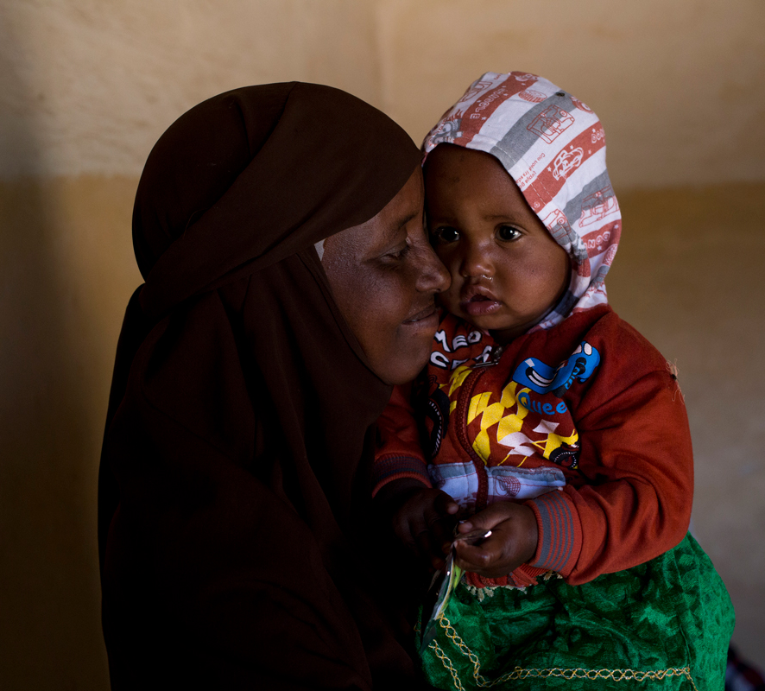
Humanitarian and development programming

Slide 31
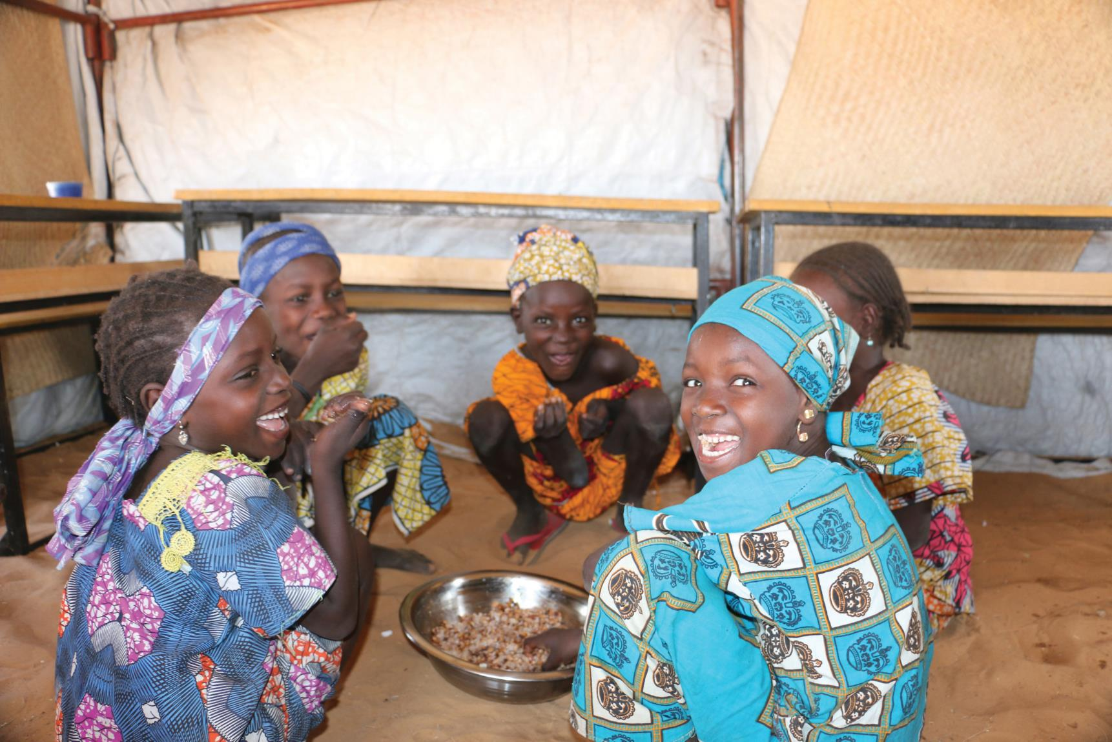
Rome-based Agencies Resilience Initiative
Recurrent and protracted crises prevent the most vulnerable people to move out of food insecurity
Multi-year funding allows the RBAs to jointly provide sustained support by
  strengthening livelihoods
  building resilience to shocks
  simultaneously protecting food and nutrition needs

