Slide 1
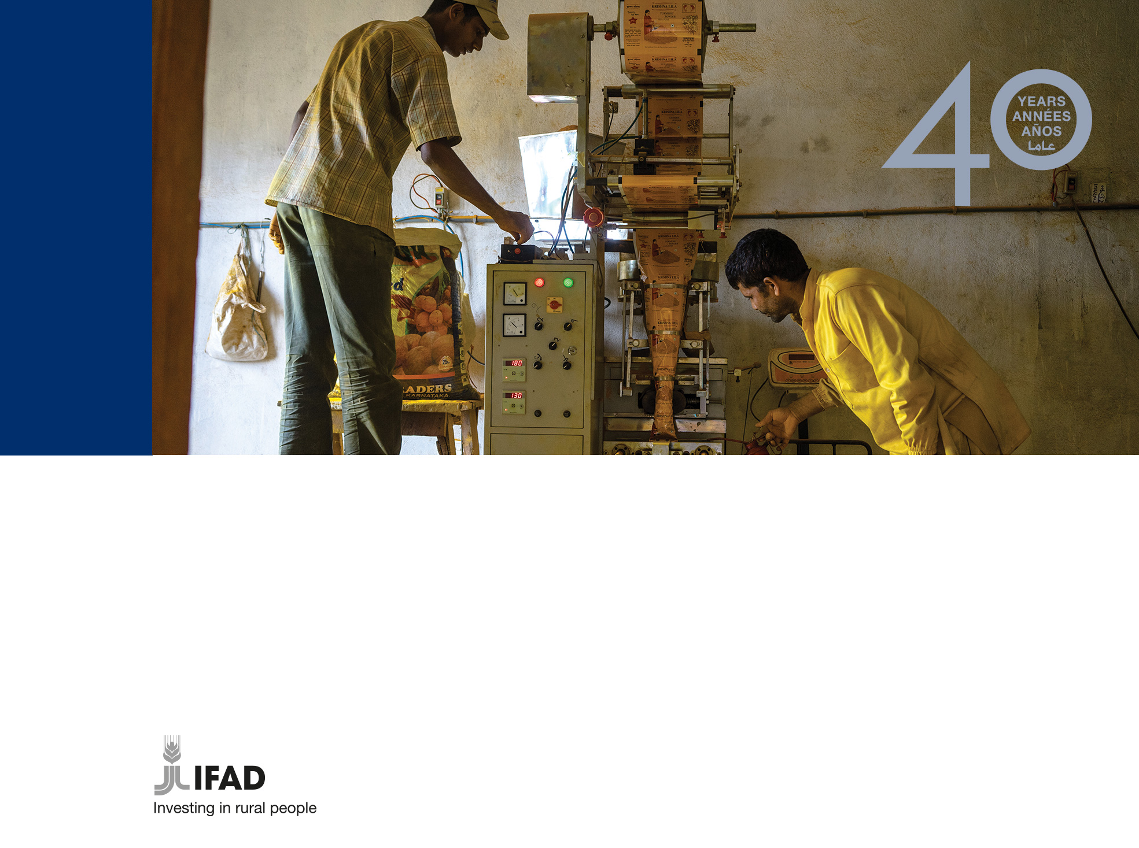
Balancing innovation, change and continuity while investing in and advocating for rural communities
Susan Beccio
Regional Communication Officer for Asia and the Pacific
External Relations and Governance Department
TU Berlin, 5 June 2018

Slide 2
Poverty and hunger in rural areas
836 million people are living in extreme poverty
The number of chronically undernourished people in the world is rising (777 million in 2015 – 815 million in 2016)
Approximately 80% of the extreme poor live in rural areas and 65% work in agriculture

Slide 3
Rural people at the center of development
IFAD invests in rural people, empowering them to:
    Increase food security
    Improve nutrition
    Increase incomes
    Strengthen resilience
    Expand their businesses
    Take charge of their own development

Slide 4
The International Fund for Agricultural Development (IFAD)
IFAD is an international financial institution and a specialized United Nations agency based in Rome – the UN’s food and agriculture hub.
Since 1978, IFAD has provided about US$20.2 billion in grants and low-interest loans to projects that have reached some 476 million people.

Slide 5
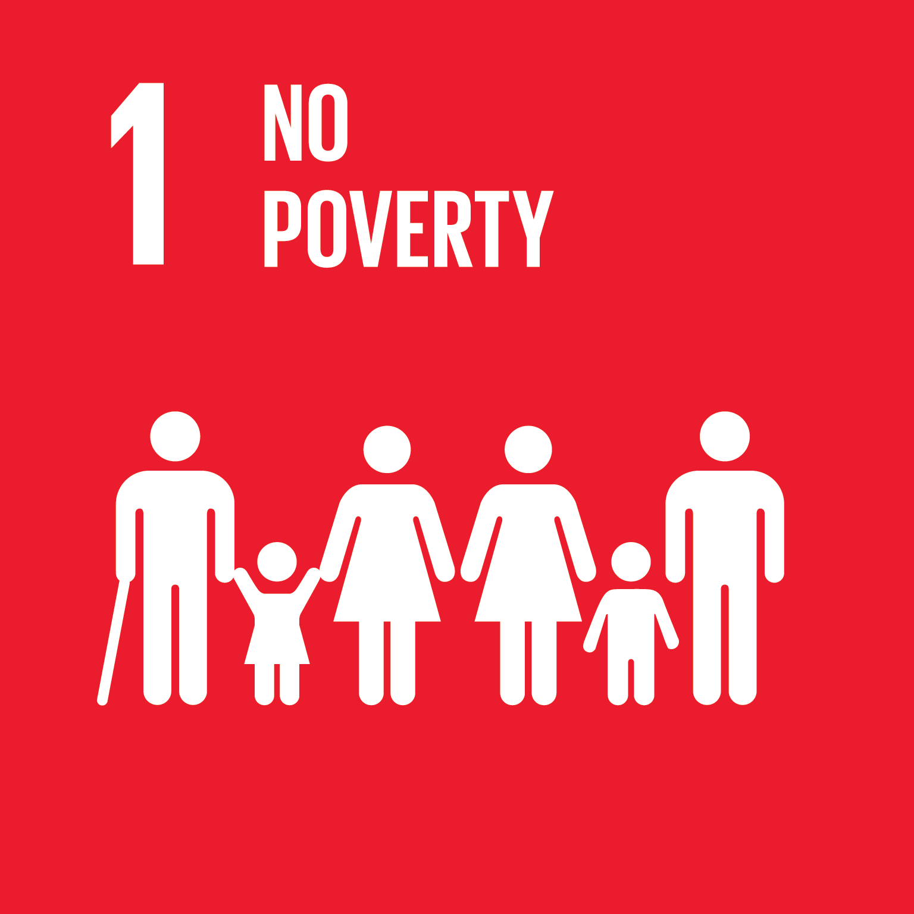
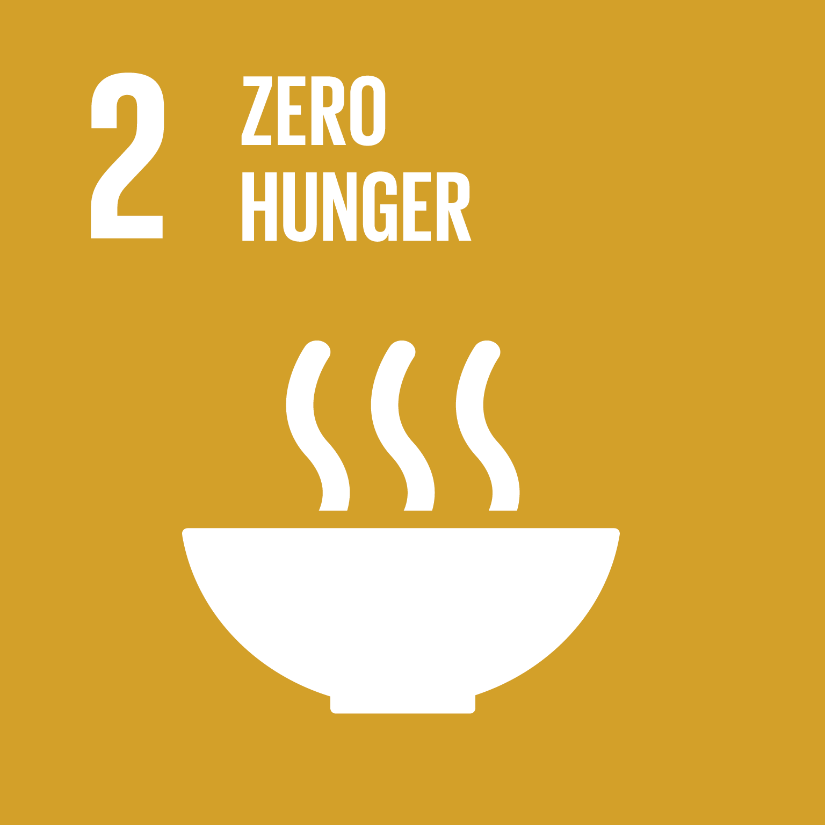
Leave no one behind
The 2030 Agenda’s overarching aim is to leave no one behind
IFAD’s mandate is as crucial today as it was when we were founded 40 years ago
Poverty, hunger and inequality – are not new challenges
But climate change, mass migration, forced displacement and population growth are huge obstacles to reduce poverty and hunger to zero by 2030

Slide 6
Smallholder farmers can contribute
Rural communities are often remote, marginalized and lack basic infrastructure and services
Rural people are skilled, resourceful, and as small-scale producers can significantly contribute to global food security
IFAD uses targeting strategies to ensure that the most vulnerable are reached – with solutions to move out of hunger and poverty.

Slide 7
Targeted investments

Slide 8
Thematic areas
IFAD’s mainstreaming agenda focuses on nutrition, women’s empowerment, youth, environmental sustainability and climate change.

Slide 9
Focus on youth
In Africa alone, 10 to 12 million young people are entering the job market every year.
With the right policies and investments, agriculture can drive economic growth and create decent jobs in rural areas.
IFAD is committed to investing in young rural people, building their skills and empowering them to fulfill their potential.

Slide 10
40 Years of investing in rural people

Slide 11
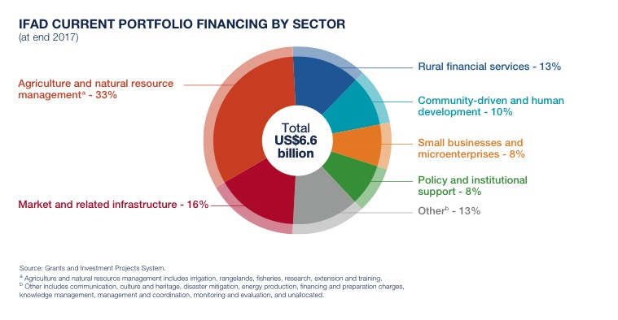
IFAD’s current portfolio by sector

Slide 12
Where IFAD works

Slide 13
2017 Report of IFAD’s Development Effectiveness

Slide 14
Asia and the Pacific

Slide 15
East and Southern Africa

Slide 16
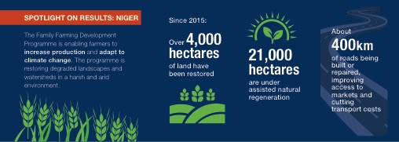
West and Central Africa

Slide 17
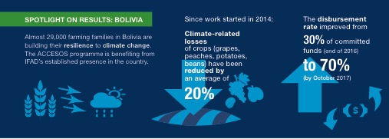
Latin America and the Caribbean

Slide 18
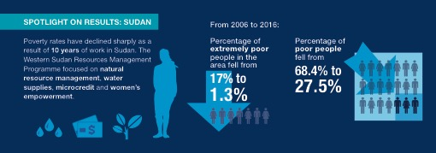
Near East, North Africa and Europe

Slide 19
Sudan: Seed Money
Rural women are often the poorest people in Sudanese communities, and they have few opportunities to improve their lives. Now a micro-finance scheme is giving rural women access to loans to start businesses, transforming them from subsistence farmers to entrepreneurs - and giving them decision-making roles in their families and communities.
https://www.youtube.com/watch?v=EPLNm7EnHW8

Slide 20
For more information
IFAD website
www.ifad.org
Susan Beccio
s.beccio@ifad.org

