Slide 1
Pastoralists under threat
Prof. Dr. Brigitte Fahrenhorst (TU Berlin / Society for International Development)

Slide 2
Background
7 years PhD research in West Africa
Study in East Africa and Horn of Africa on behalf of IGAD
Study in Sudan on behalf of World Bank
SUNARPA – Sustainable Use of Natural Resources and Peace in Africa (funded by the African Union)

Slide 3
contents
What is pastoralism? Pastoralist way of life
Where are pastoralists living?
Pastoralists in Africa
Social organization
Challenges & Threats
Impact

Slide 4
1. What is pastoralism? Pastoralist way of life
People migrating with animals – cows/ cattle, camel, goats, lamas, yaks etc.
200-400 mio. worldwide
Using natural grasslands as pasture
Ecologically adapted lifestyle, moving with climatic conditions
Base camp – animal breeding, milk production
Land = common property (exclusive using rights). Animals = family property

Slide 5
Small business: some honey, gum arabicum, charcoal
No school or hospital
Living mostly in semi-arid areas
Livelihood
Migrating with the rain
Migrating with the cattle
Living from milk and blood
Gathering
Cooperation / exchange with farmers

Slide 6
2. Where are pasto-ralists living?
https://www.slideshare.net/marcfoggin/sustainable-pastoralism-on-the-tibetan-plateau

Slide 7
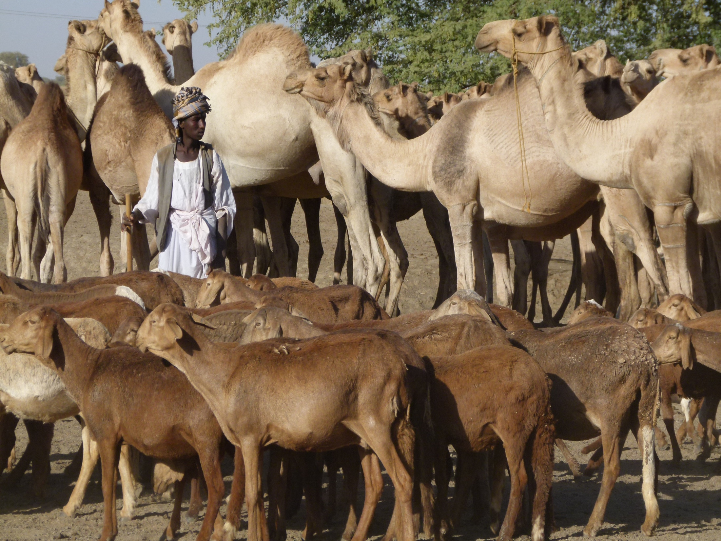
Africa

Slide 8
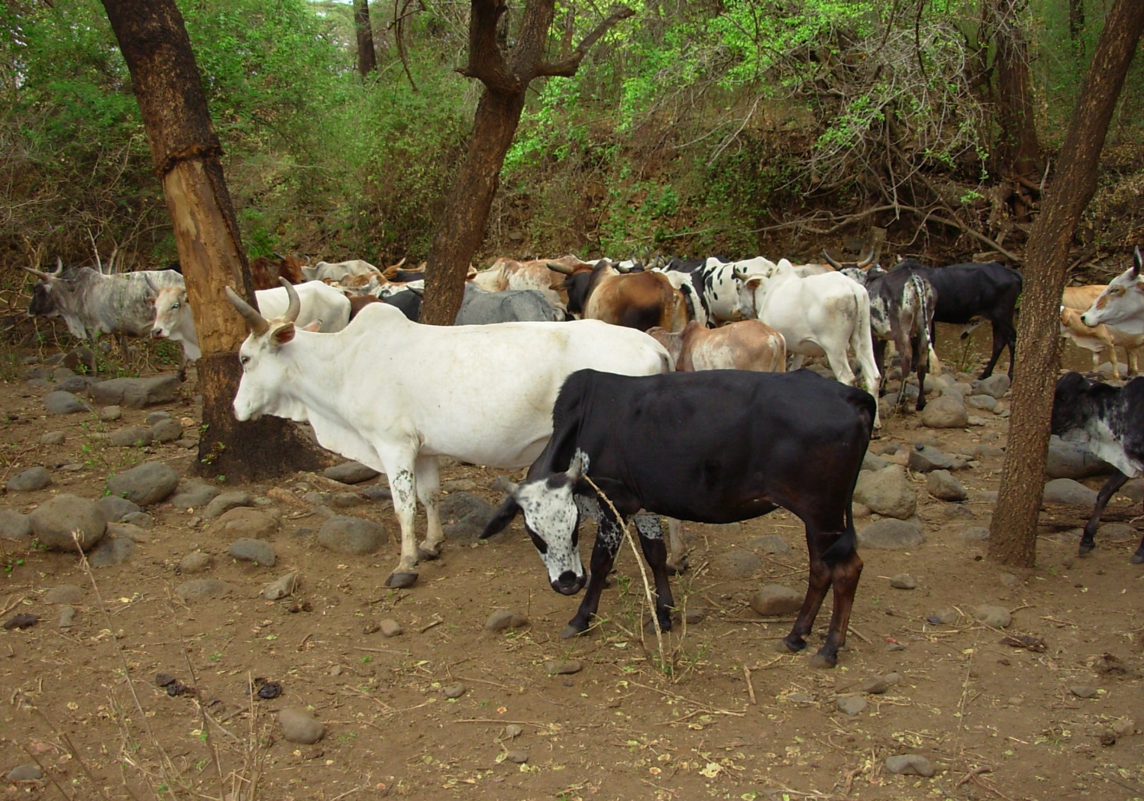
Africa

Slide 9
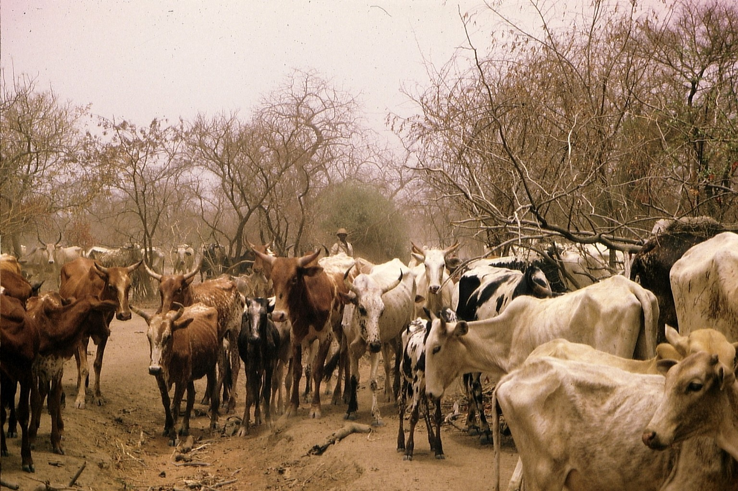
Africa

Slide 10
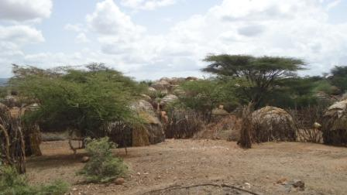
Settle- ment

Slide 11
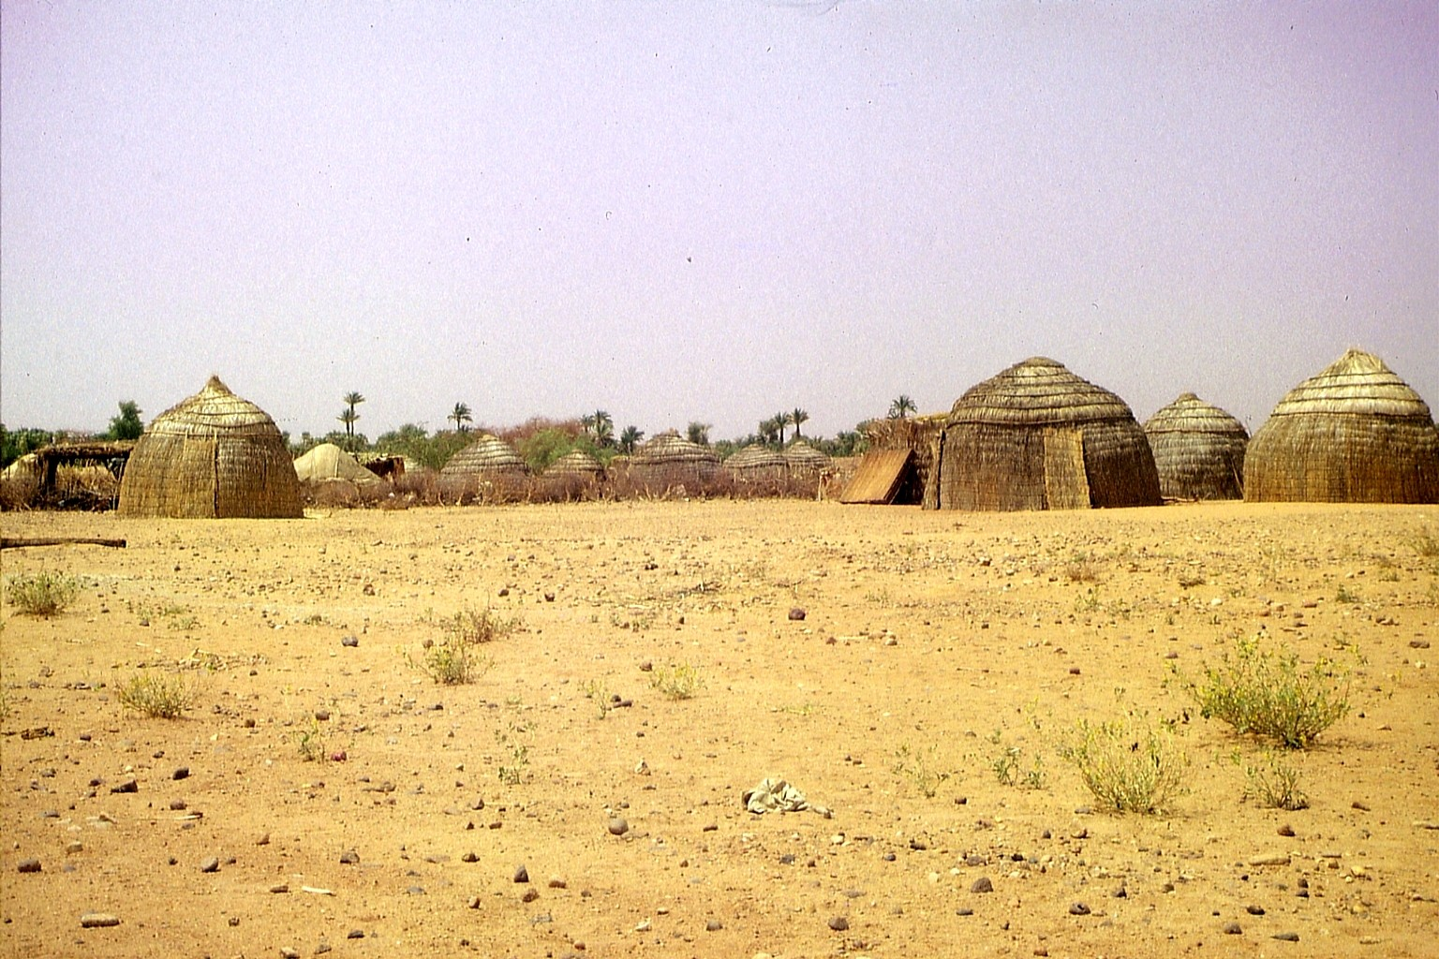
Settlement

Slide 12
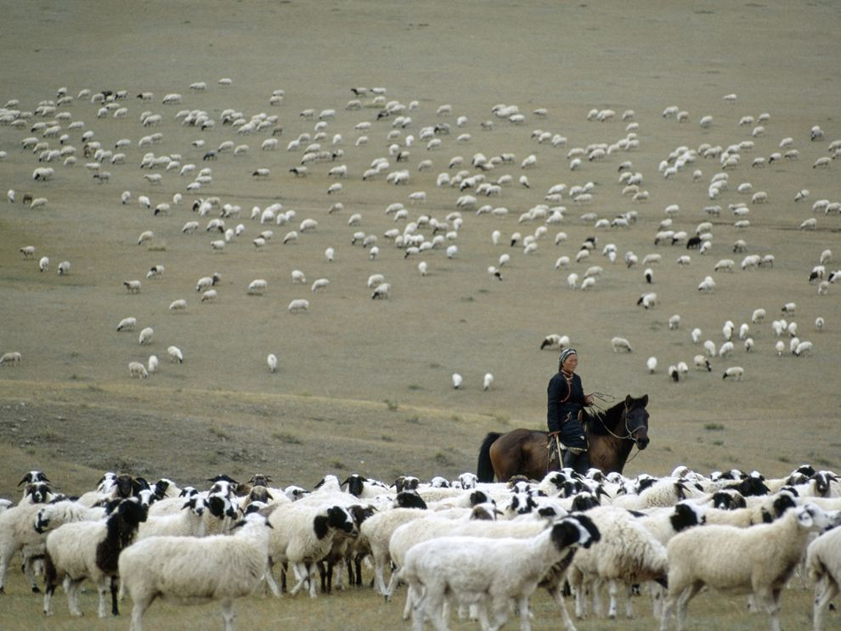
Asia
https://www.nationalgeographic.org/encyclopedia/herding/

Slide 13
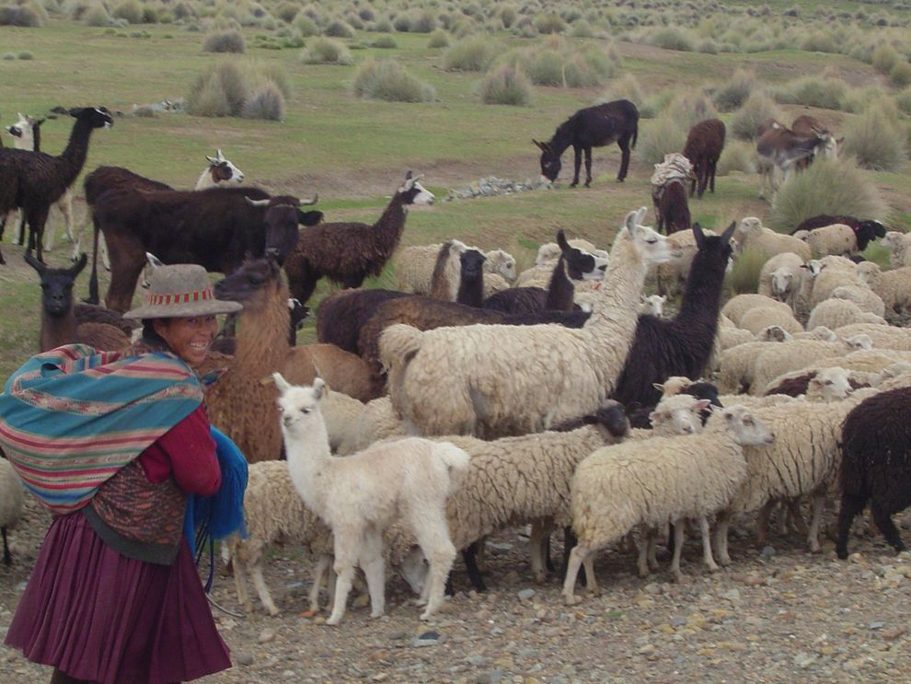
Latin America
https://www.nationalgeographic.org/encyclopedia/herding/

Slide 14
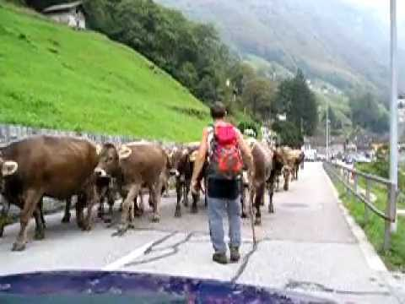
The Alpes
https://www.google.com/search?q=foto+schweiz+viehauftrieb&tbm=isch&source=iu&ictx=1&fir=2Ifzjw8uloKzpM%253A%252Cu6ksCP9E_8yWKM%252C_&vet=1&usg=AI4_-kQW1FGS7DTTmVow8hSkaRlpyJUwuQ&sa=X&ved=2ahUKEwjD2vLv66riAhVR6KQKHZhwBoQQ9QEwCXoECAgQCA#imgrc=nadXEileL9rNMM:&vet=1
https://www.youtube.com/watch?v=TeM3p_dNAP4

Slide 15
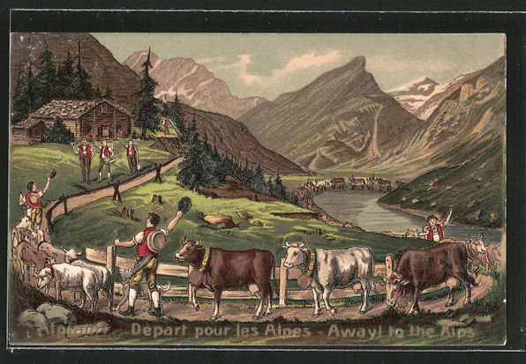
The Alpes - Europe
https://oldthing.de/Praege-AK-Viehtrieb-in-den-Alpen-Kuehe-und-Schafe-Depart-pour-les-Alpes-0024754841#gallery-1

Slide 16
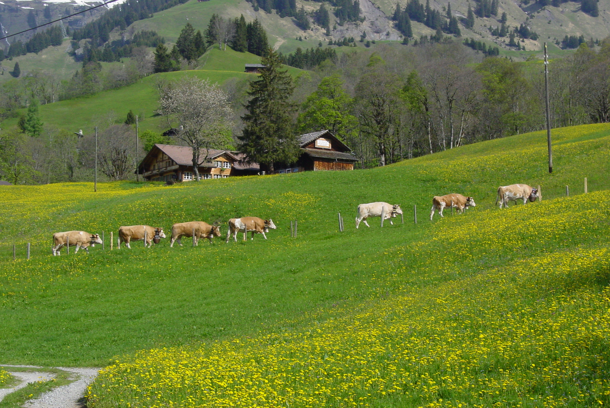
The Alpes - Europe
https://de.wikipedia.org/wiki/Almauftrieb

Slide 17
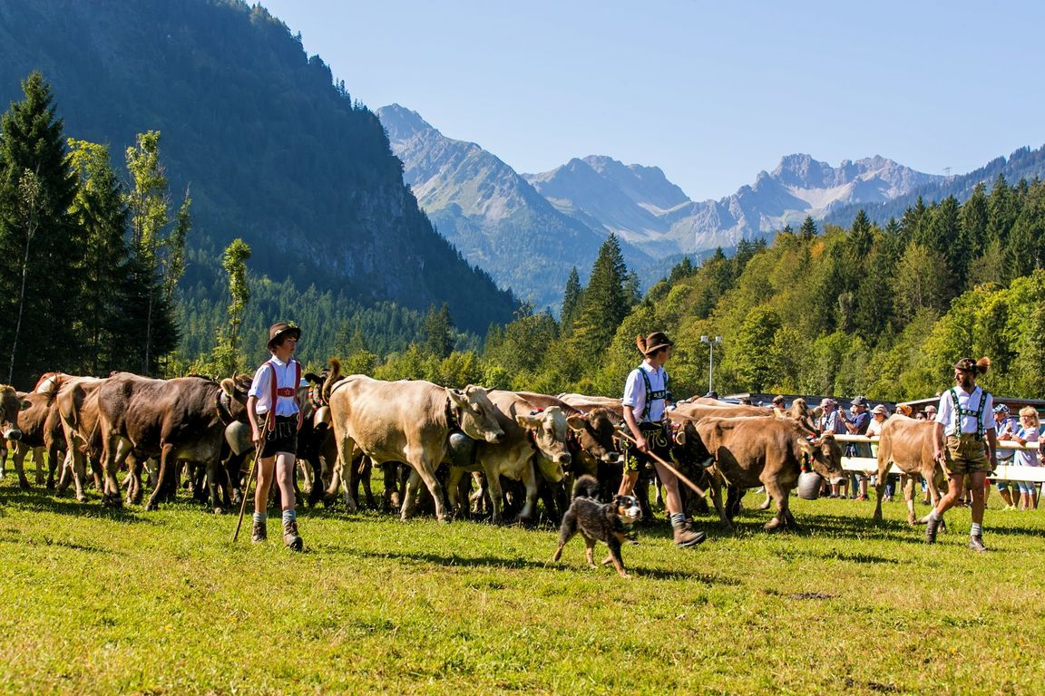
Foto: Ralf Lienert https://allgaeu.life/galerie_fotos,-vorfreude-viehscheide-im-allgaeu-_mediagalid,643.html

Slide 18
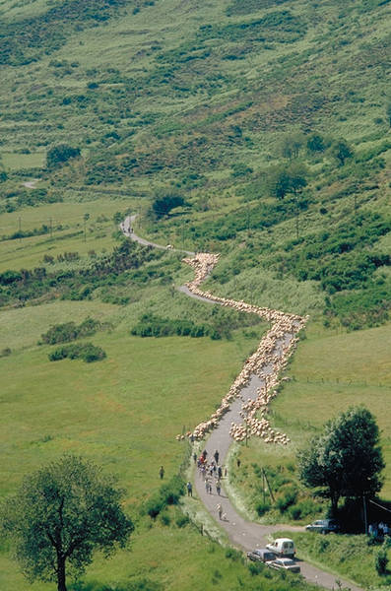
The Alpes - Europe

Slide 19
3. Pastoralists in Africa
UNDP 2007

Slide 20
4. Social organization
Leadership:
fluctuating, male candidate with competence & balanced social behaviour until better one entering arena. Grazing groups: 1-2 leaders & assistants
Young men: warriors = defending group. Young leaders discuss pastures, water, migration. Consulting with elders
Elders:
wise old people with knowledge
Clan:
group of people deriving from common ancestor
Several extended families from 1 clan = grazing group
Labour division:
Women - small young animals.
Men - adult cattle
cooperative or hostile relations to other clans

Slide 21
Women:
bride price paid in a large number of cattle.
No official decision-making powers, but immense influence, also on war and peace. Women are peace makers by heart, women are main victims in the event of conflicts

Slide 22
5. Challenges & Threats
Land grapping &
Climate change: dry periods extend, drought periods more often, rainfalls less regular.
Challenges / decline
Number of cows reducing
Lack of water/ lack of pasture
poverty
Overgrazing
Deforestation (charcoal burning)
Soil erosion
Low production (1 liter milk /cow/ day)
Spreading of foreign species (plants, like prosopis chilensis)
Loss of Biodiversity

Slide 23
prosopis
https://www.google.com/search?biw=1280&bih=580&tbm=isch&sa=1&ei=n7neXNDtL4HYadGtoLgP&q=prosopis+chilensis+foto+thorns&oq=prosopis+chilensis+foto+thorns&gs_l=img.3...39418.43833..44494...3.0..0.123.1031.3j7......0....1..gws-wiz-img.ig-oETz74hE#imgrc=GOv4_PGdJmQ27M: Elizabeth Abrahamsen, Read all about how useful the widely considered pesky Mesquite Trees can be. (flickr.com/treegrow), https://www.wideopencountry.com/mesquite-trees-the-most-important-trash-trees-in-texas/

Slide 24
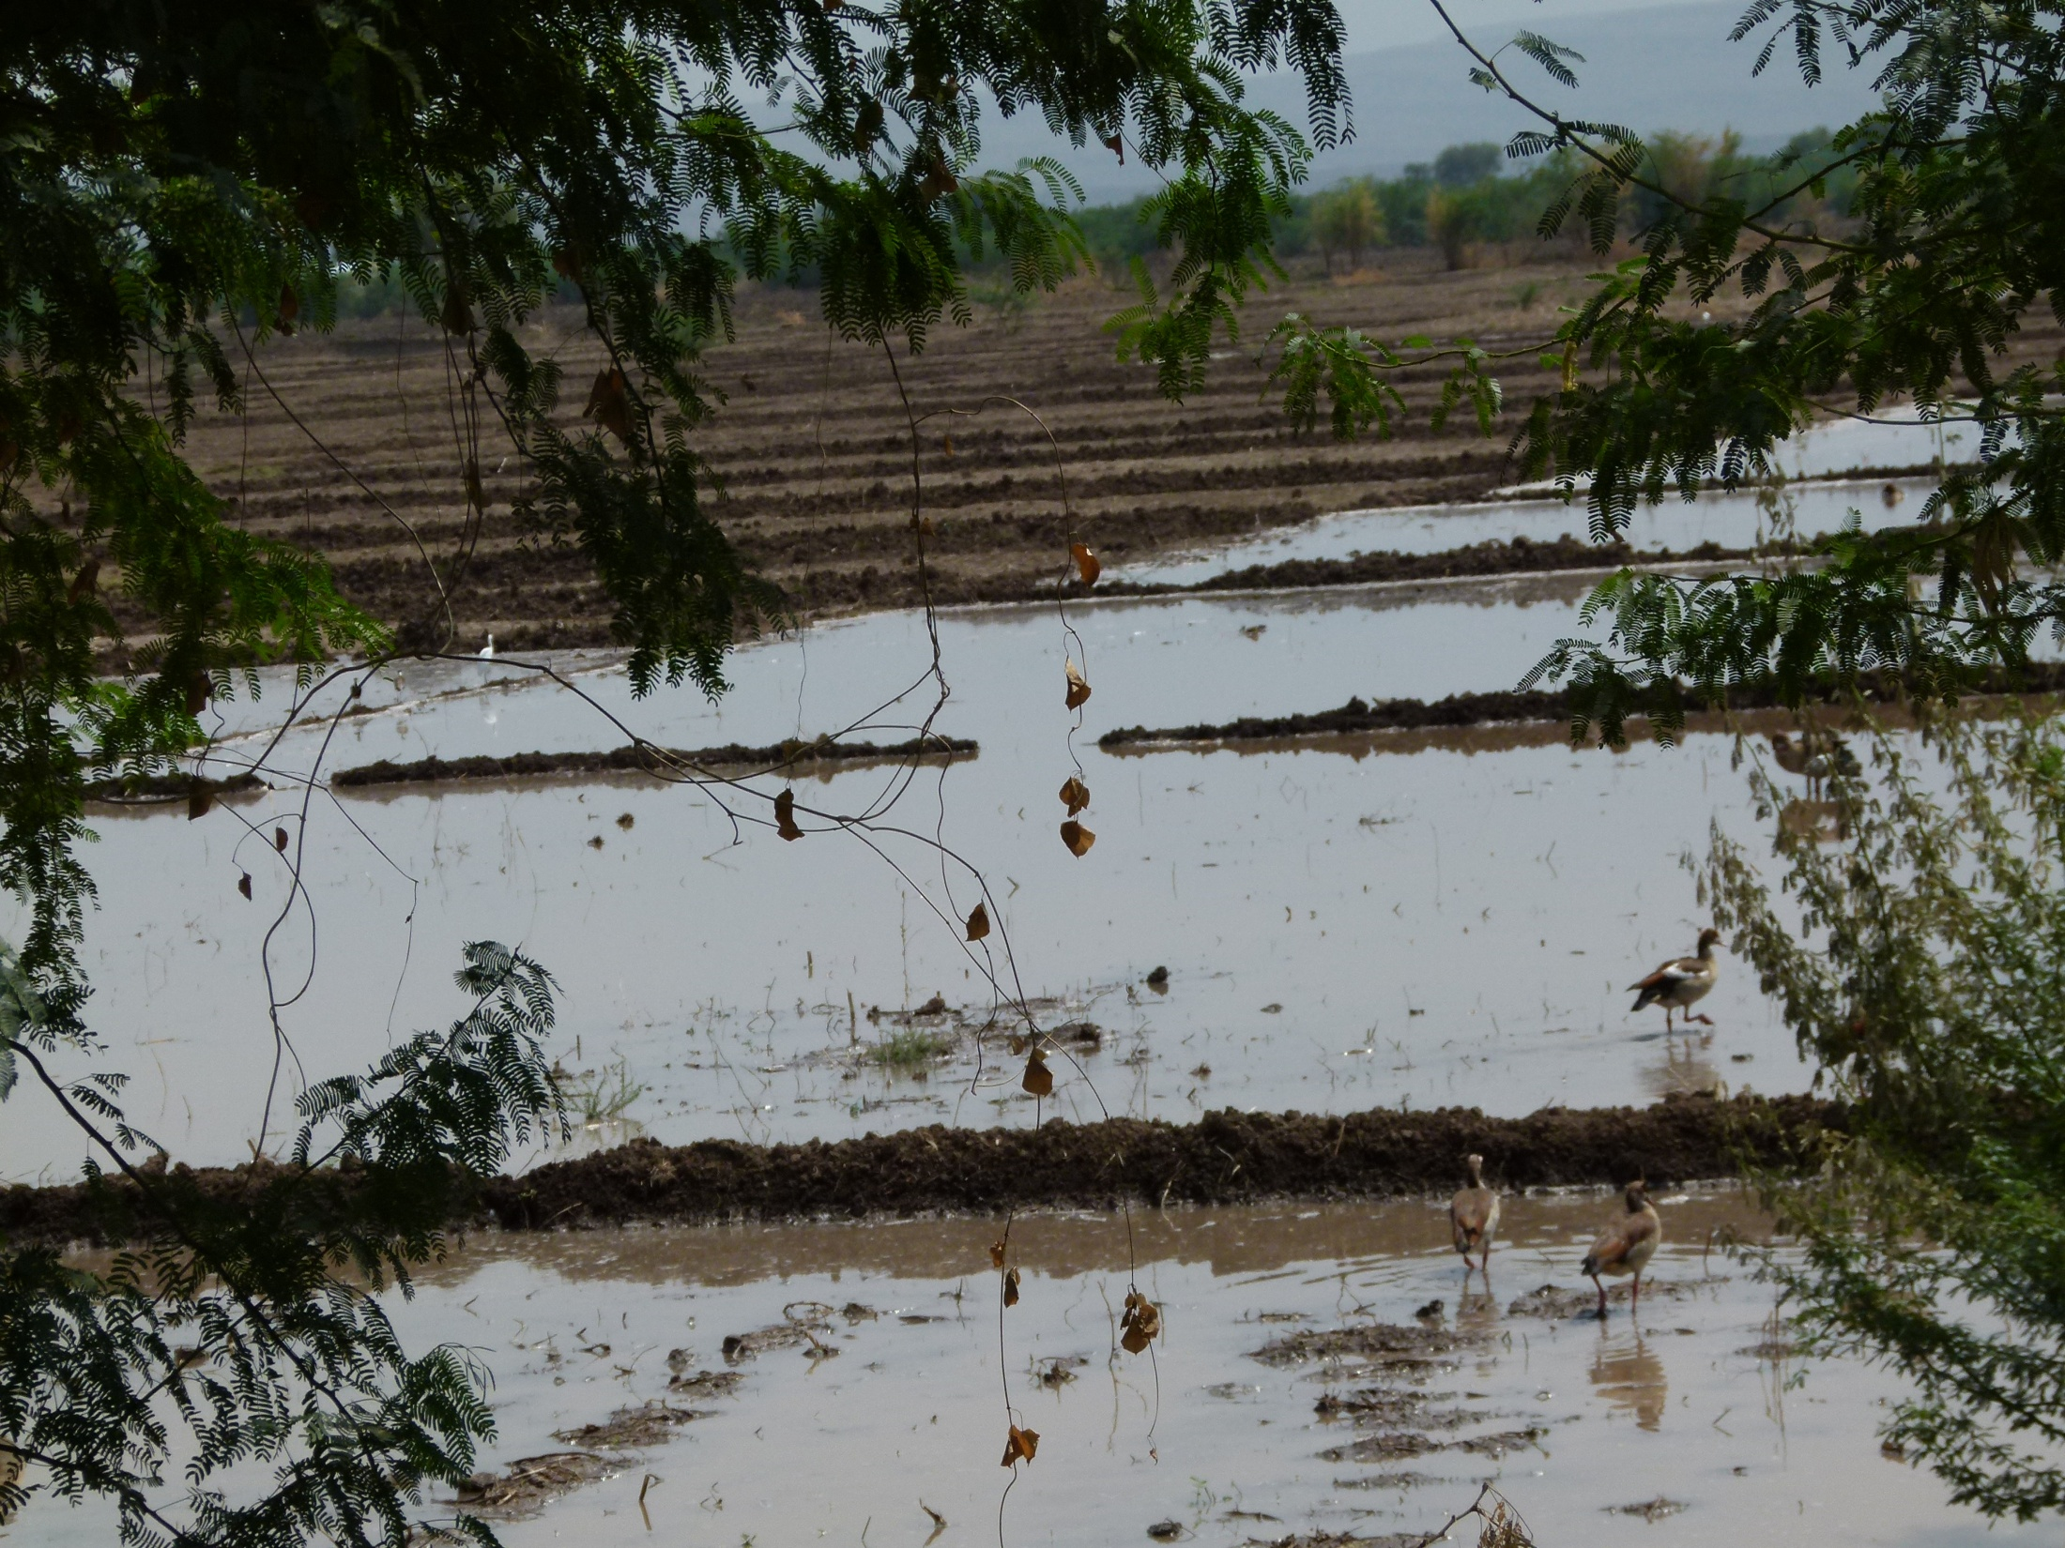
Land grapping

Slide 25
Land grapping

Slide 26
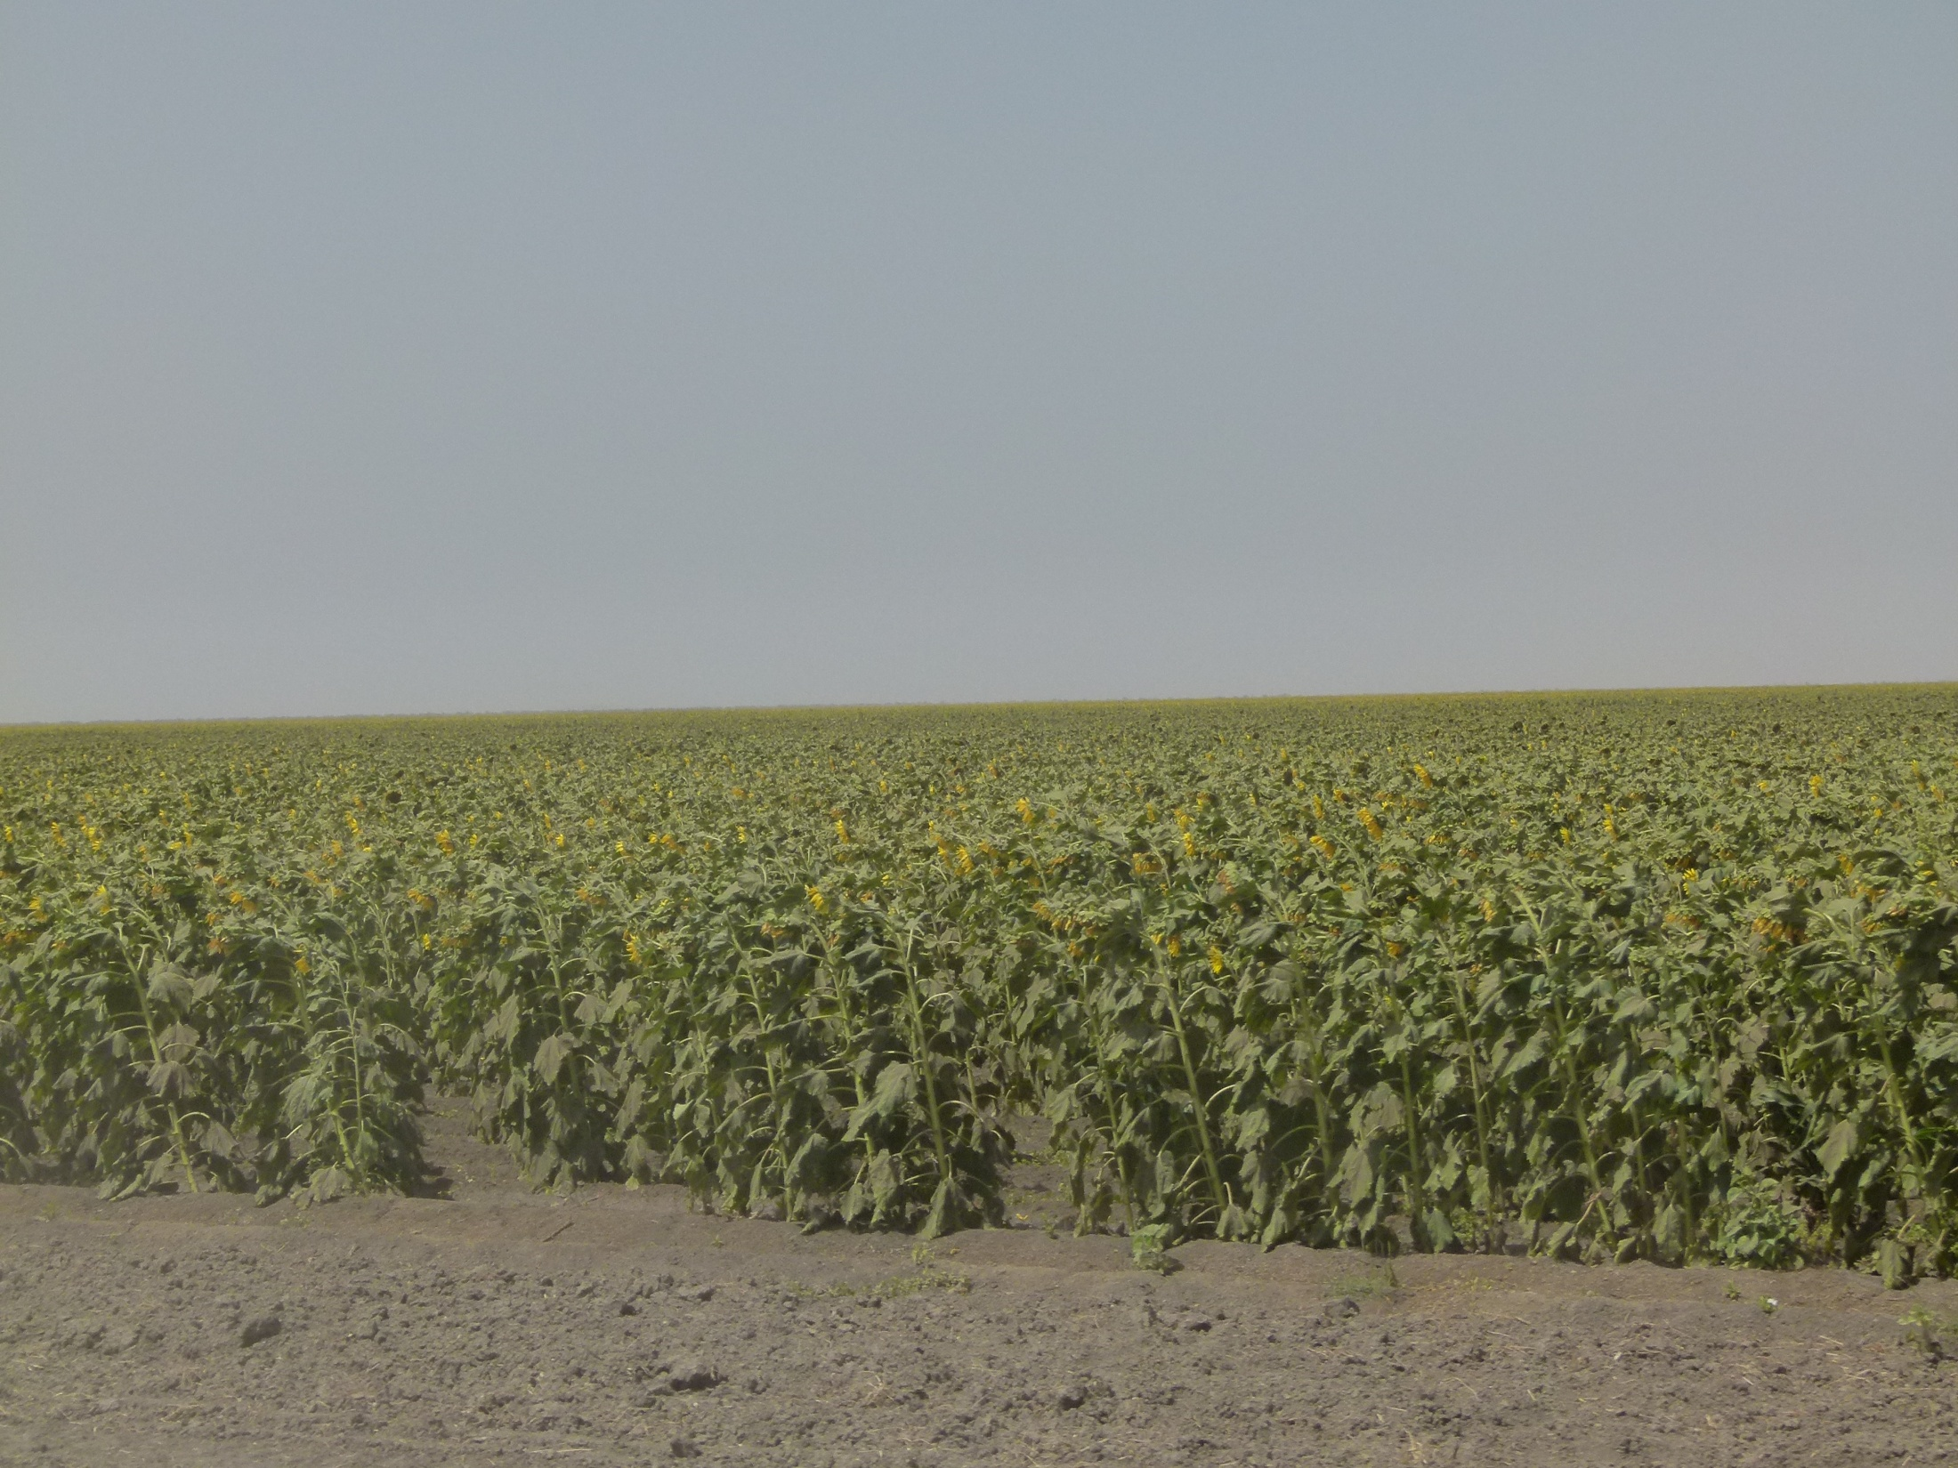
Land grapping

Slide 27
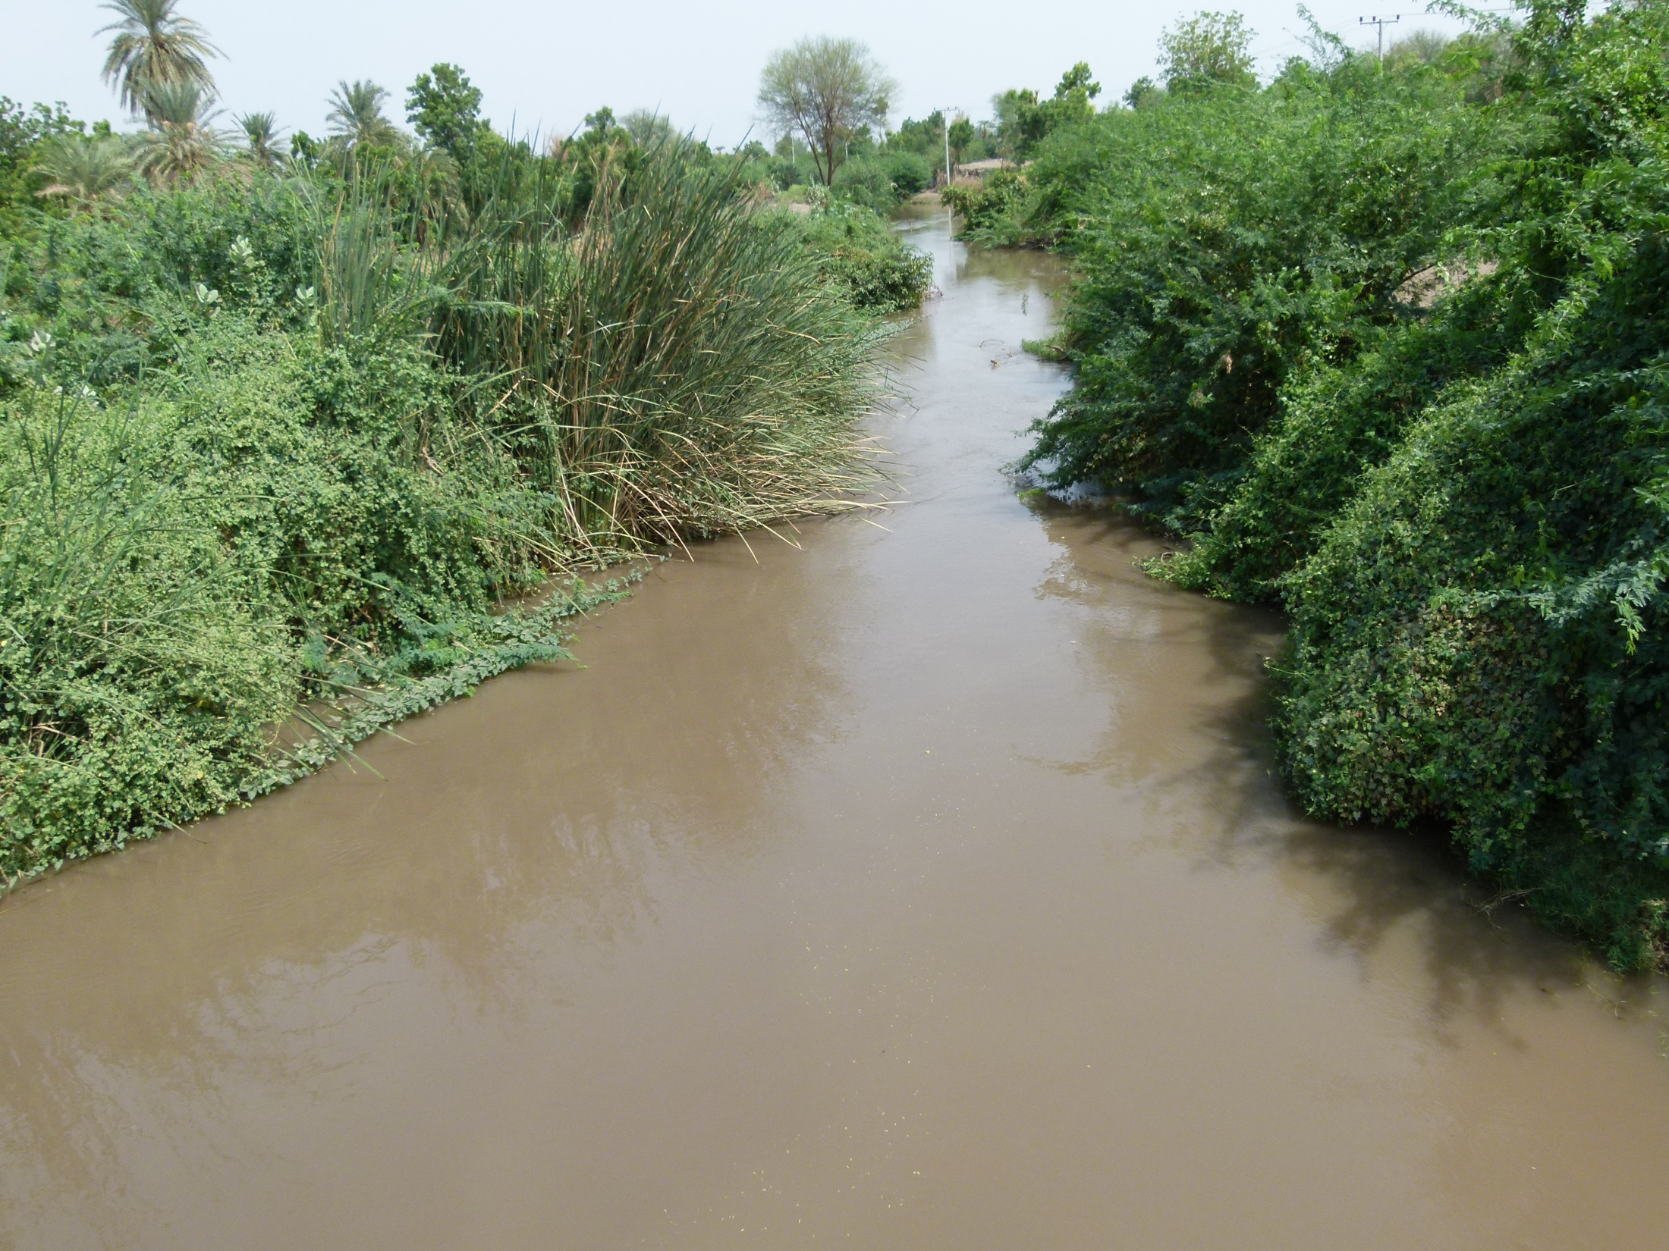
Blocking access to water

Slide 28
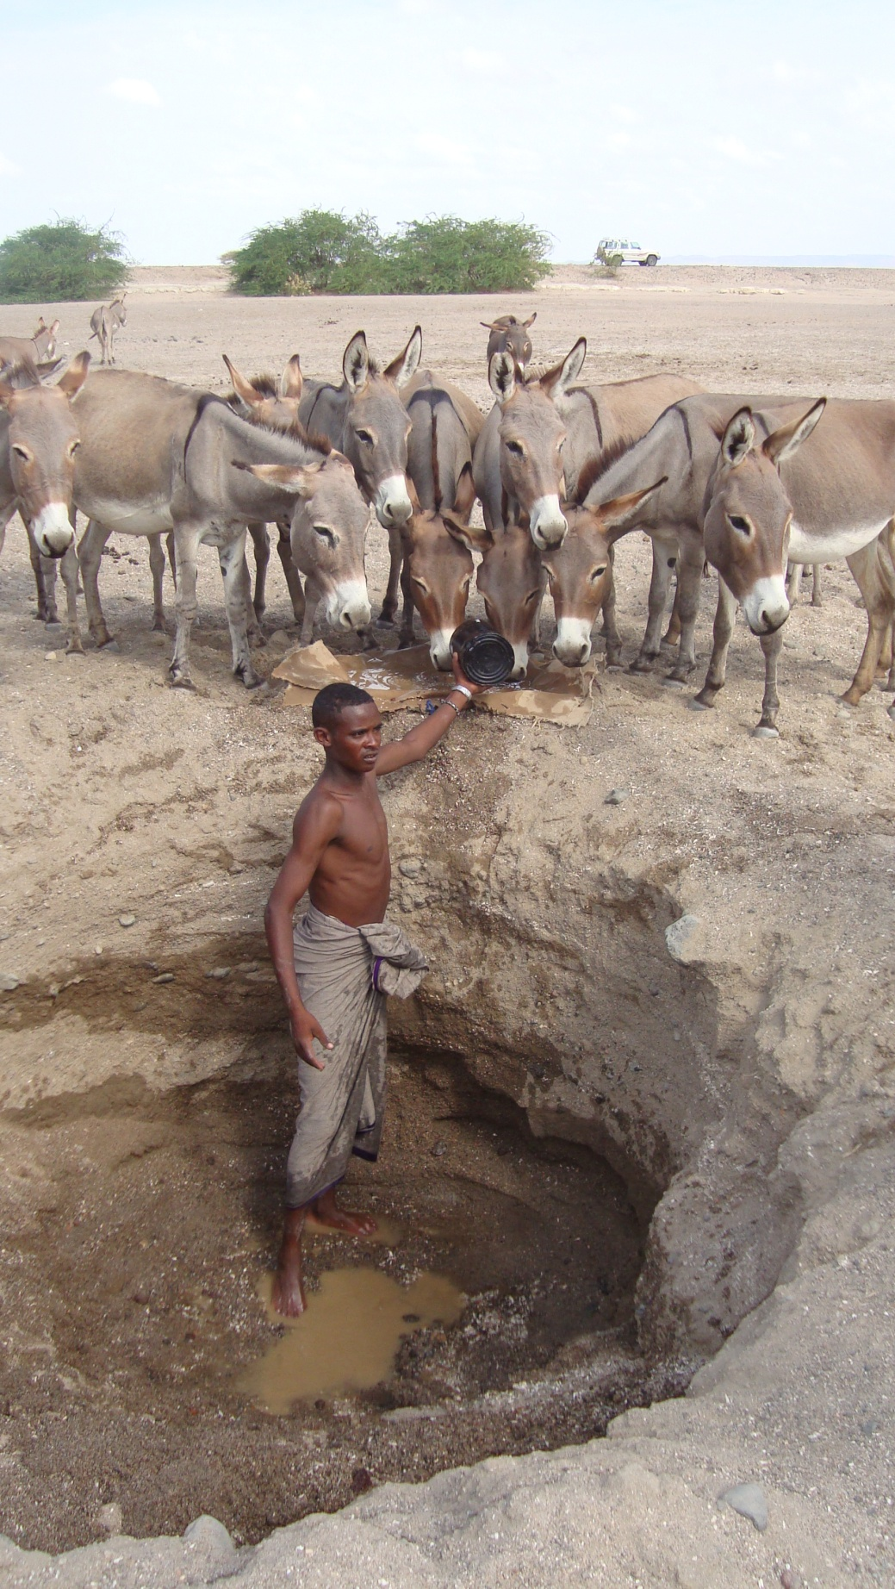
Water shortage
Photo: Ian Lane

Slide 29
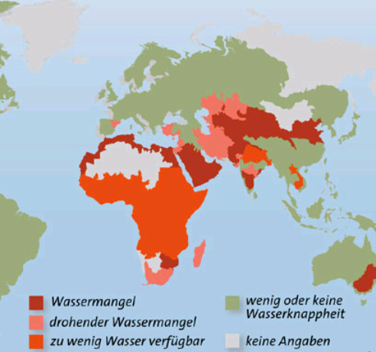

Slide 30
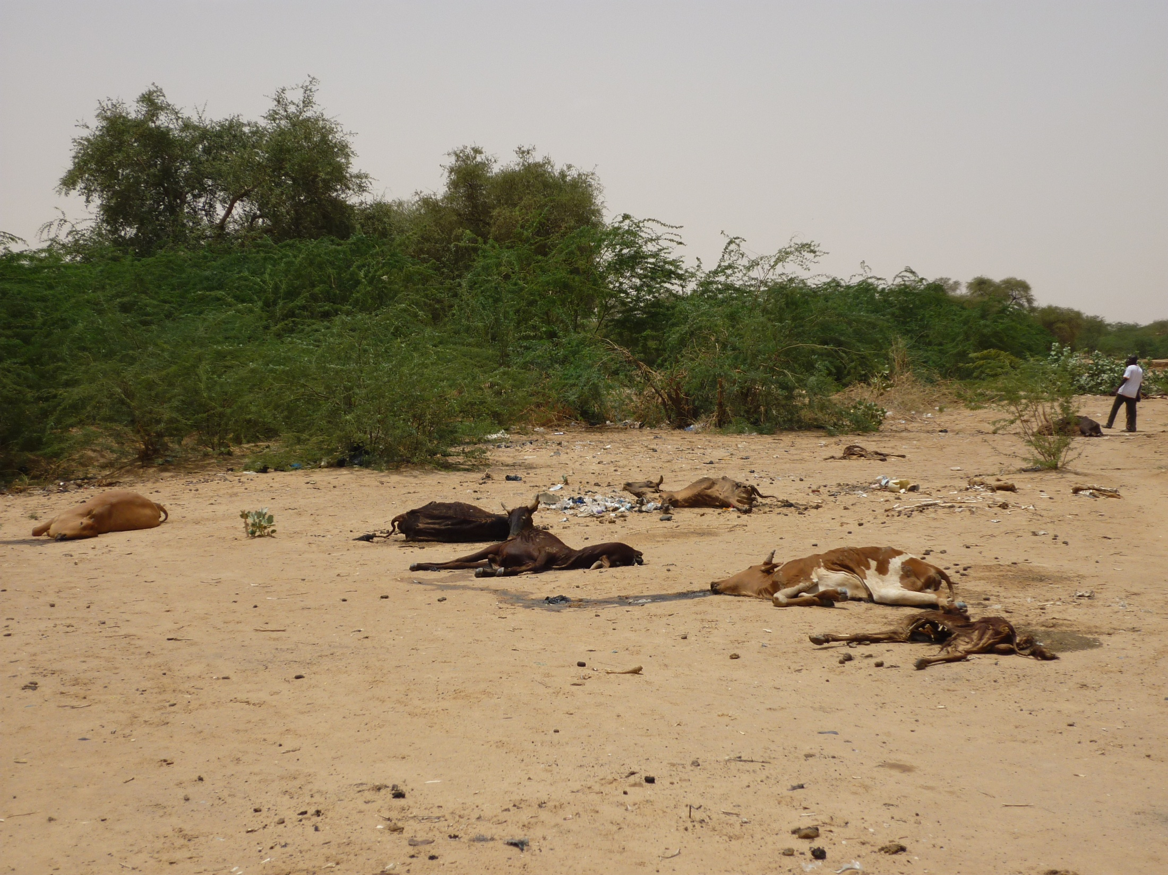
Photo: Ian Lane

Slide 31
6. Impact
migration distance increases - period of migration extends
concentration of several communities on selected pastures
economic differentiations – some still own large herds, some lost most cattle; pastoralist land registered as private property
leadership weakening: Elders loose authority
Individualization: fewer raids by entire community - more individual raiding; commercialization of raids - raid economy
Conflicts farmers - pastoralists
Social marginalization, discrimination, criminalization

Slide 32
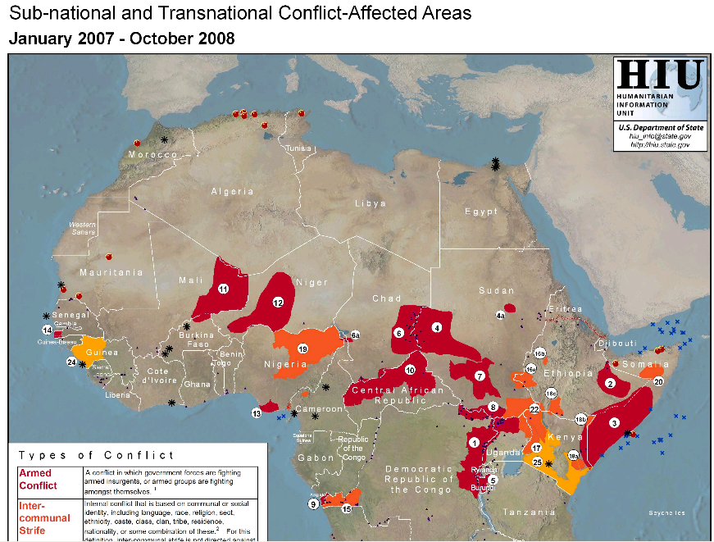
https://www.refworld.org/docid/49256ff12.html

Slide 33
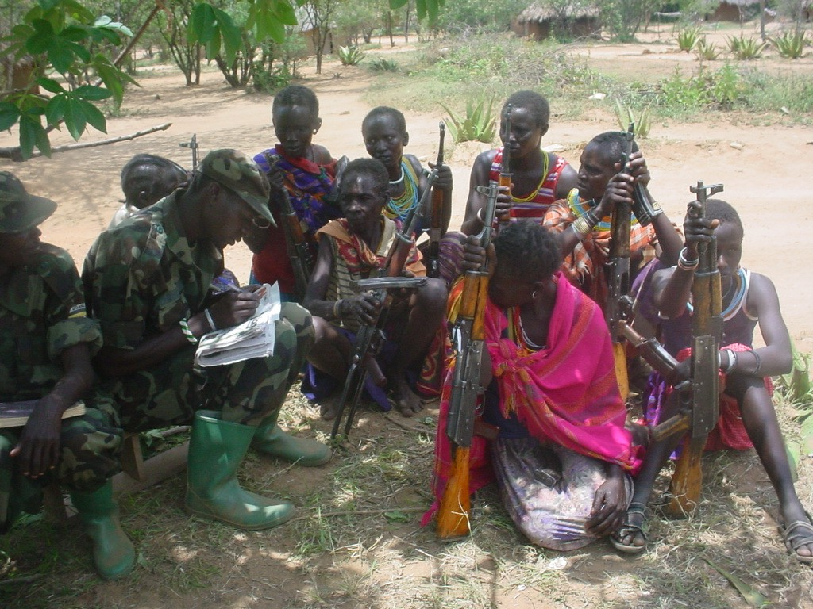

Slide 34
Photo: IGAD

